Slide 1
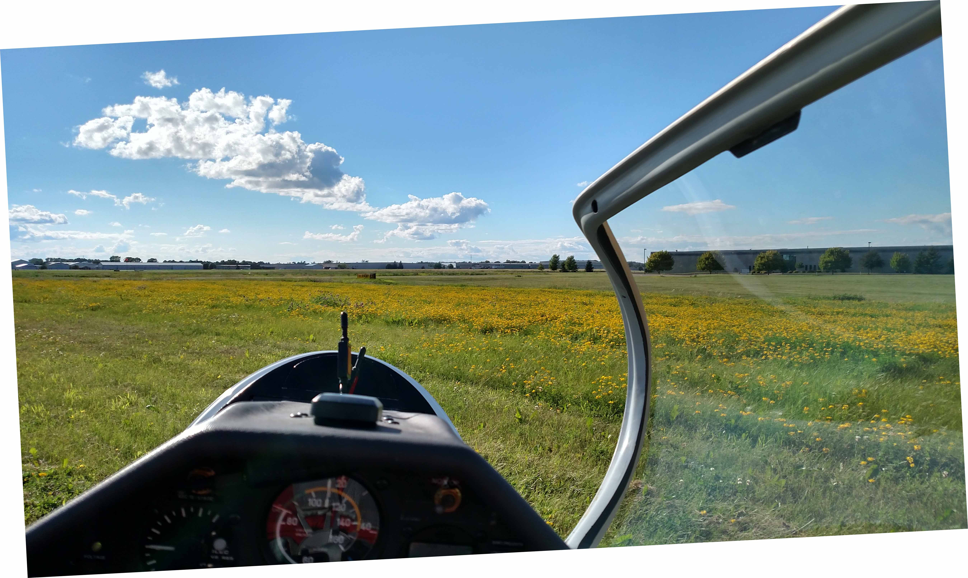
SSA 2016 OSTIV
Something Interesting with DrDan

Slide 2
A Smorgasbord
What would you like to hear about?
1: What is Senescence?
2: Can it be Postponed?
3: Shear wave...
4: Convective wave
If anything I say makes no sense, please consider it failed humor.
Notes:
Senescence is what we're all hoping to achieve, while still in good health.
What's it like?
What accelerates it?
Postponing senescence and detouring disease.
1: Breathing, eating, and activity
2: Self-discipline v. incapacity
Wave is everywhere;
Wave is evanescent.
Can we find wave usable for soaring in the plains?
(It's all about enjoying pre-senescent life)

Slide 3
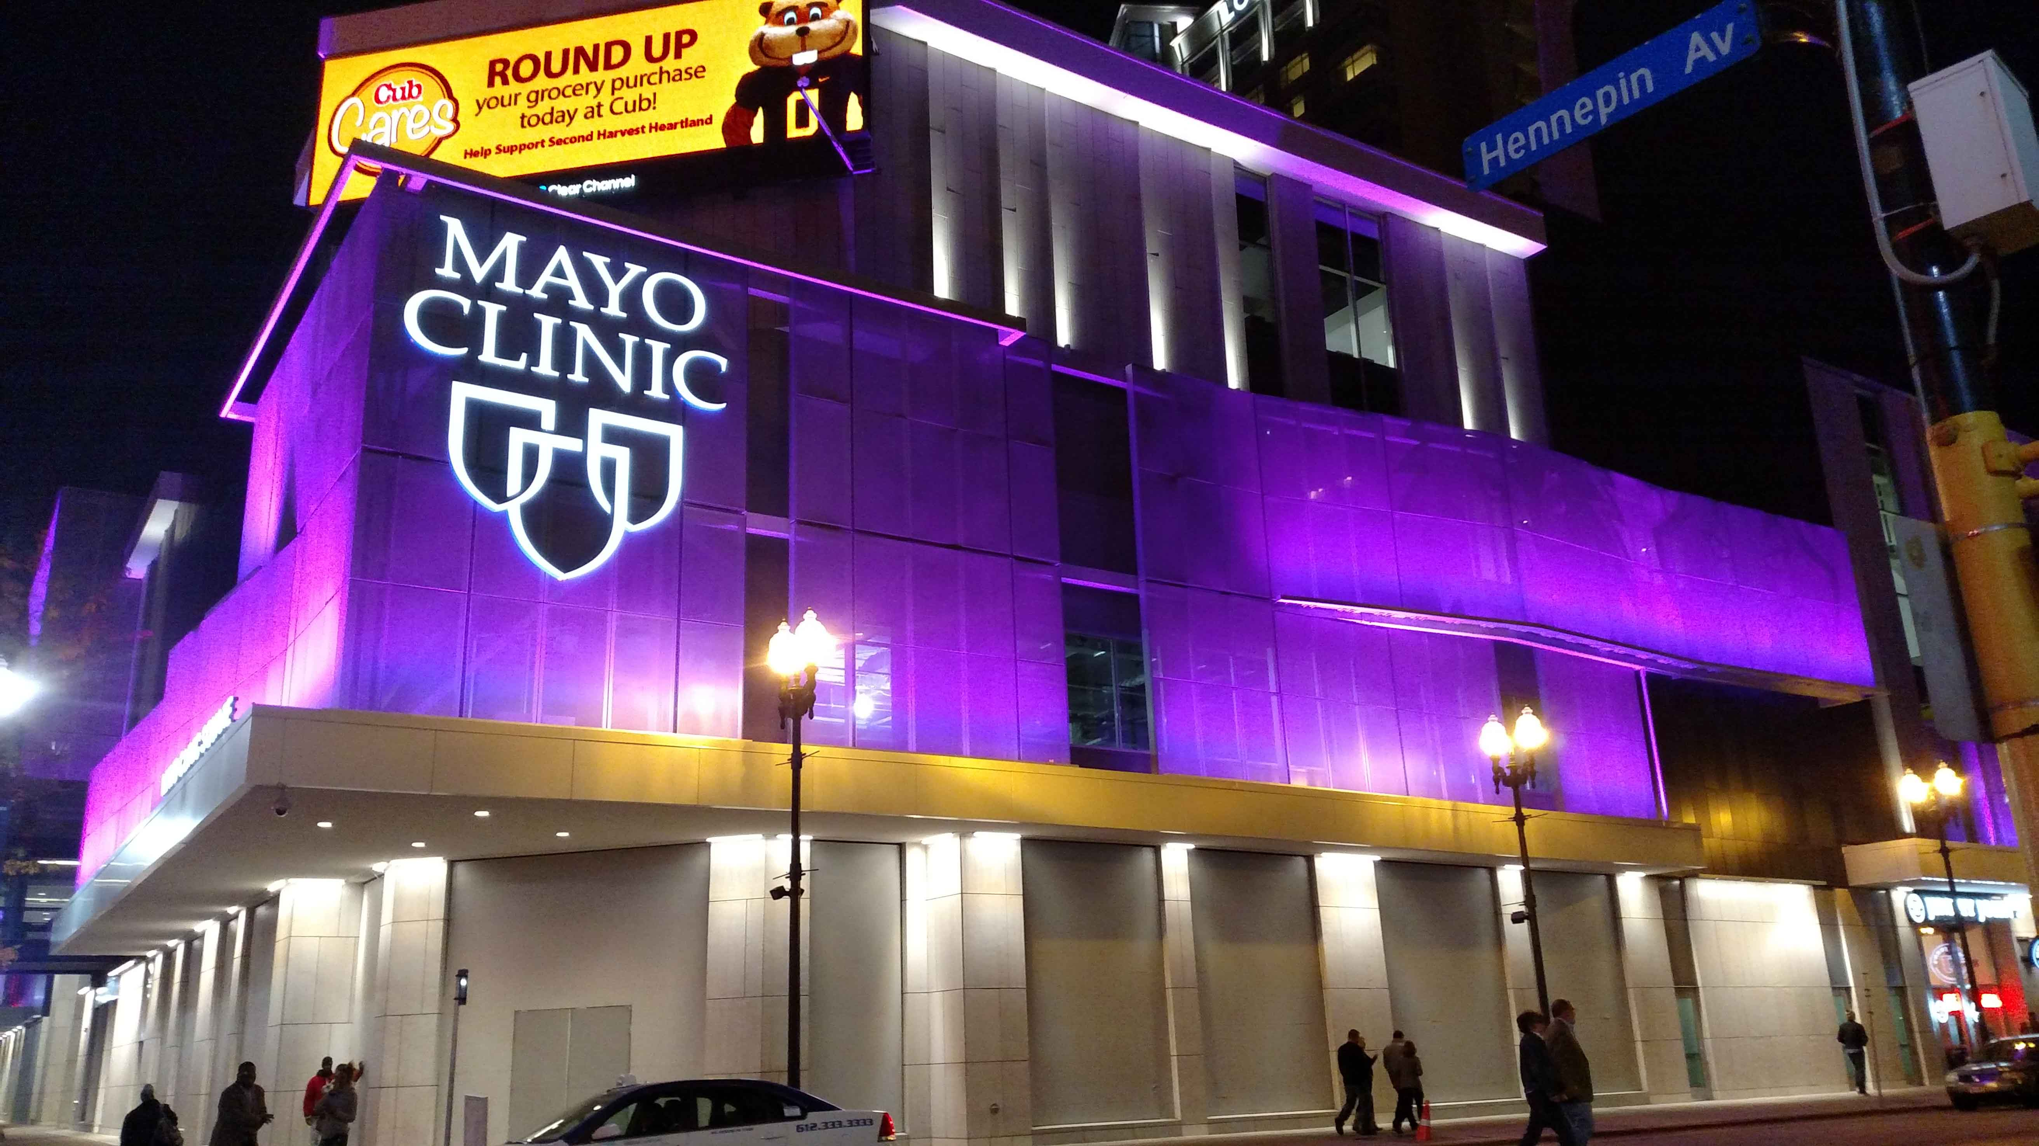
World-famous Hennepin Avenue, Minneapolis – What would Will and Charlie Mayo think? Nothing I say should be construed as a message from Mayo. Nothing. (But I hope we're reading the same texts.)

Slide 4
The Nature of Senescence
The literary idea
Medical observation of whole people
Biological research
Leaves
Animal cells
Embryos, etc
Aging animalcules

Slide 5
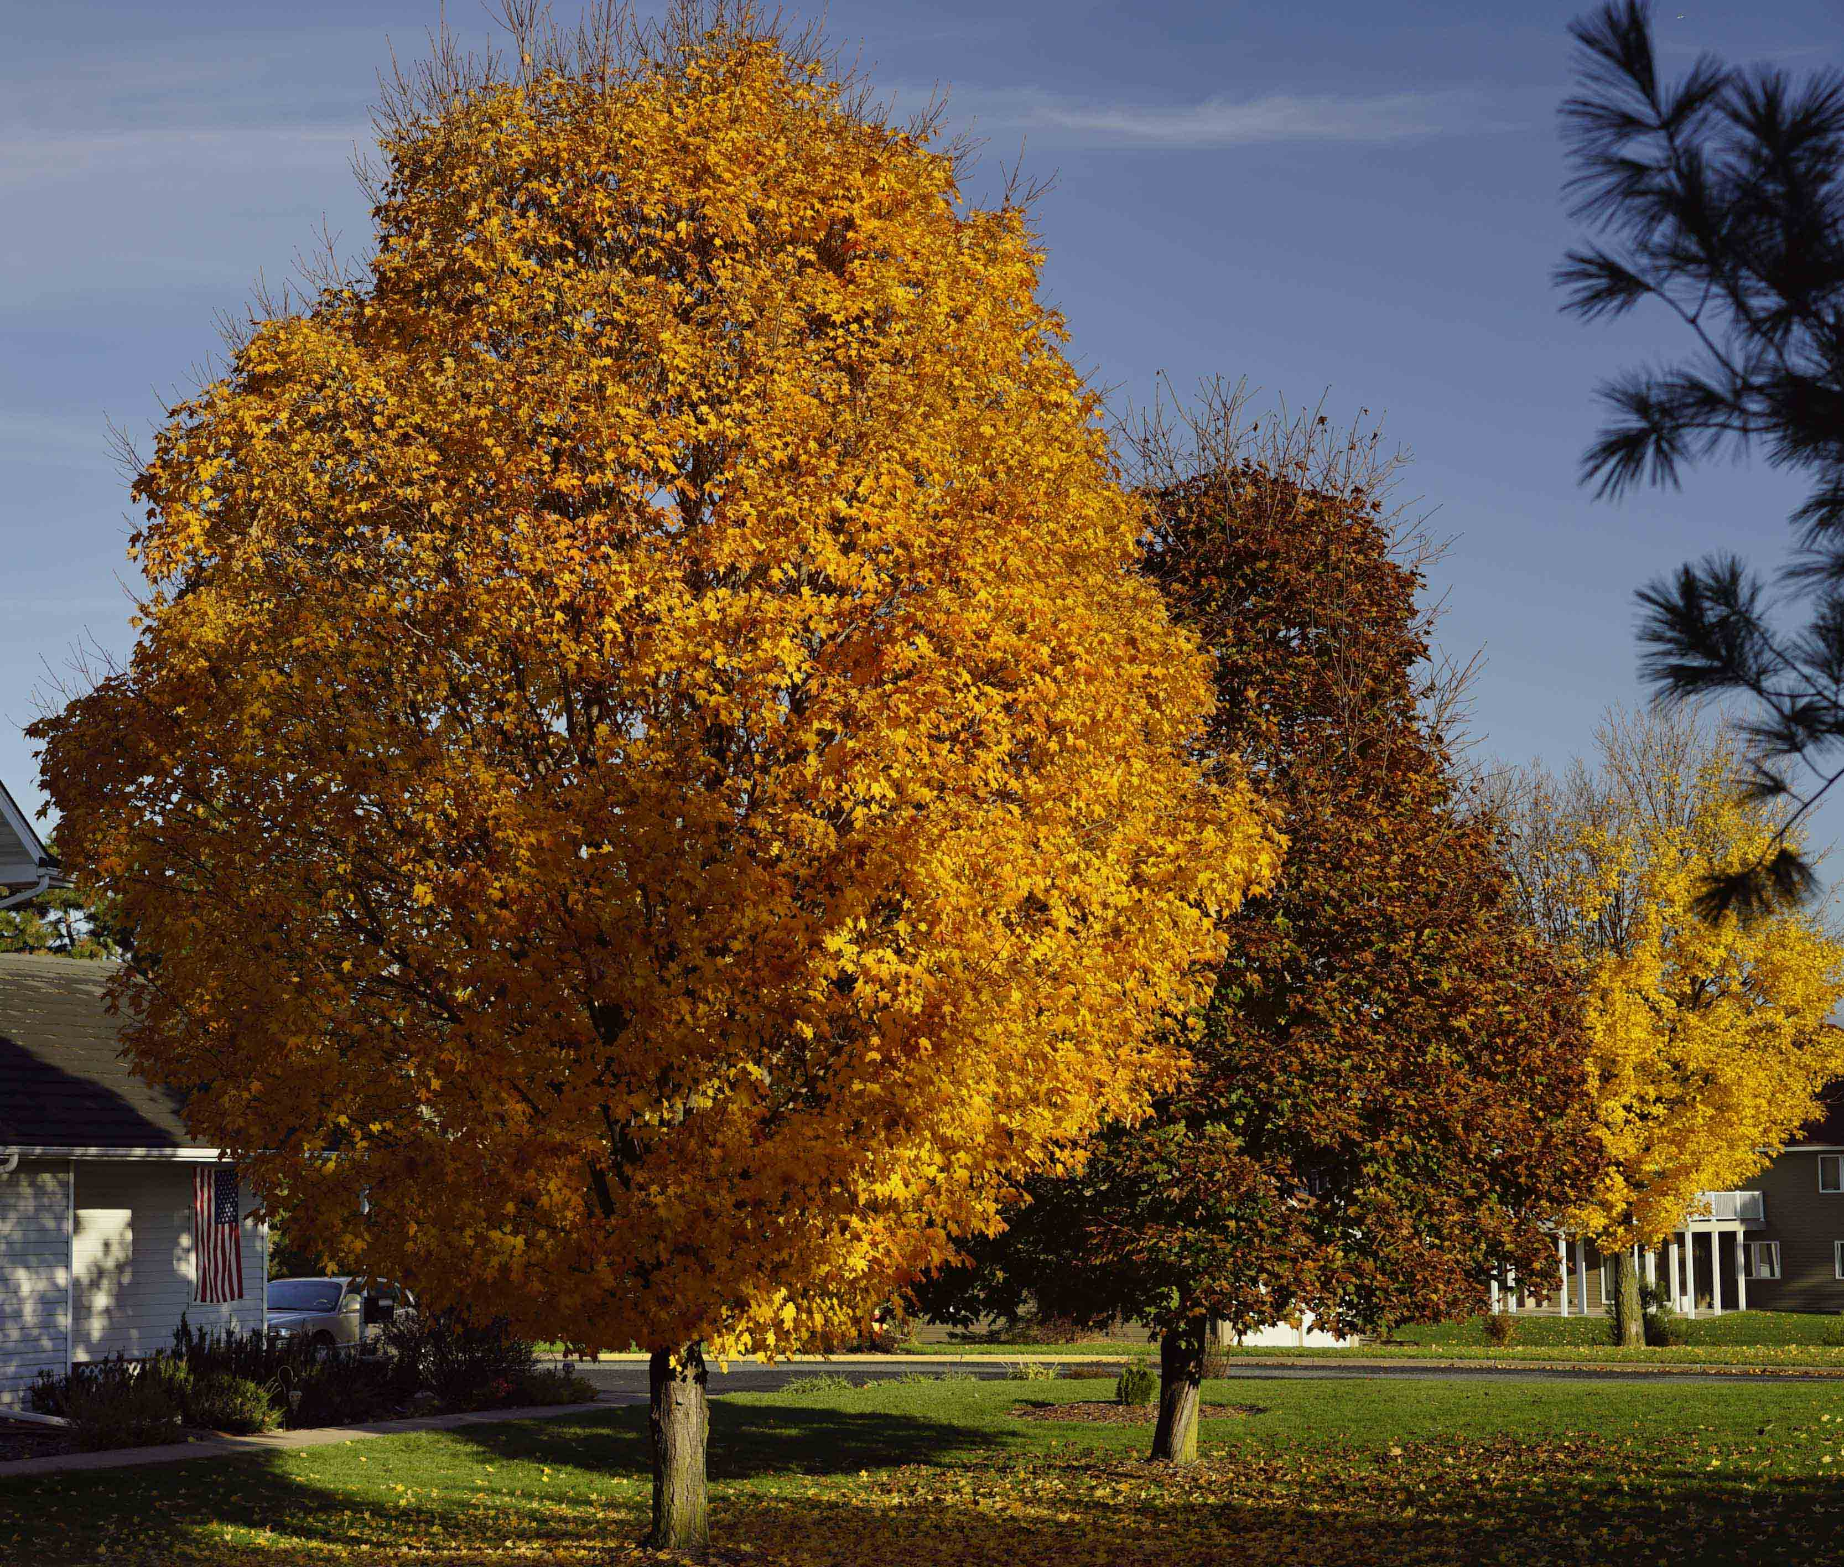
Leaf Senescence

Slide 6
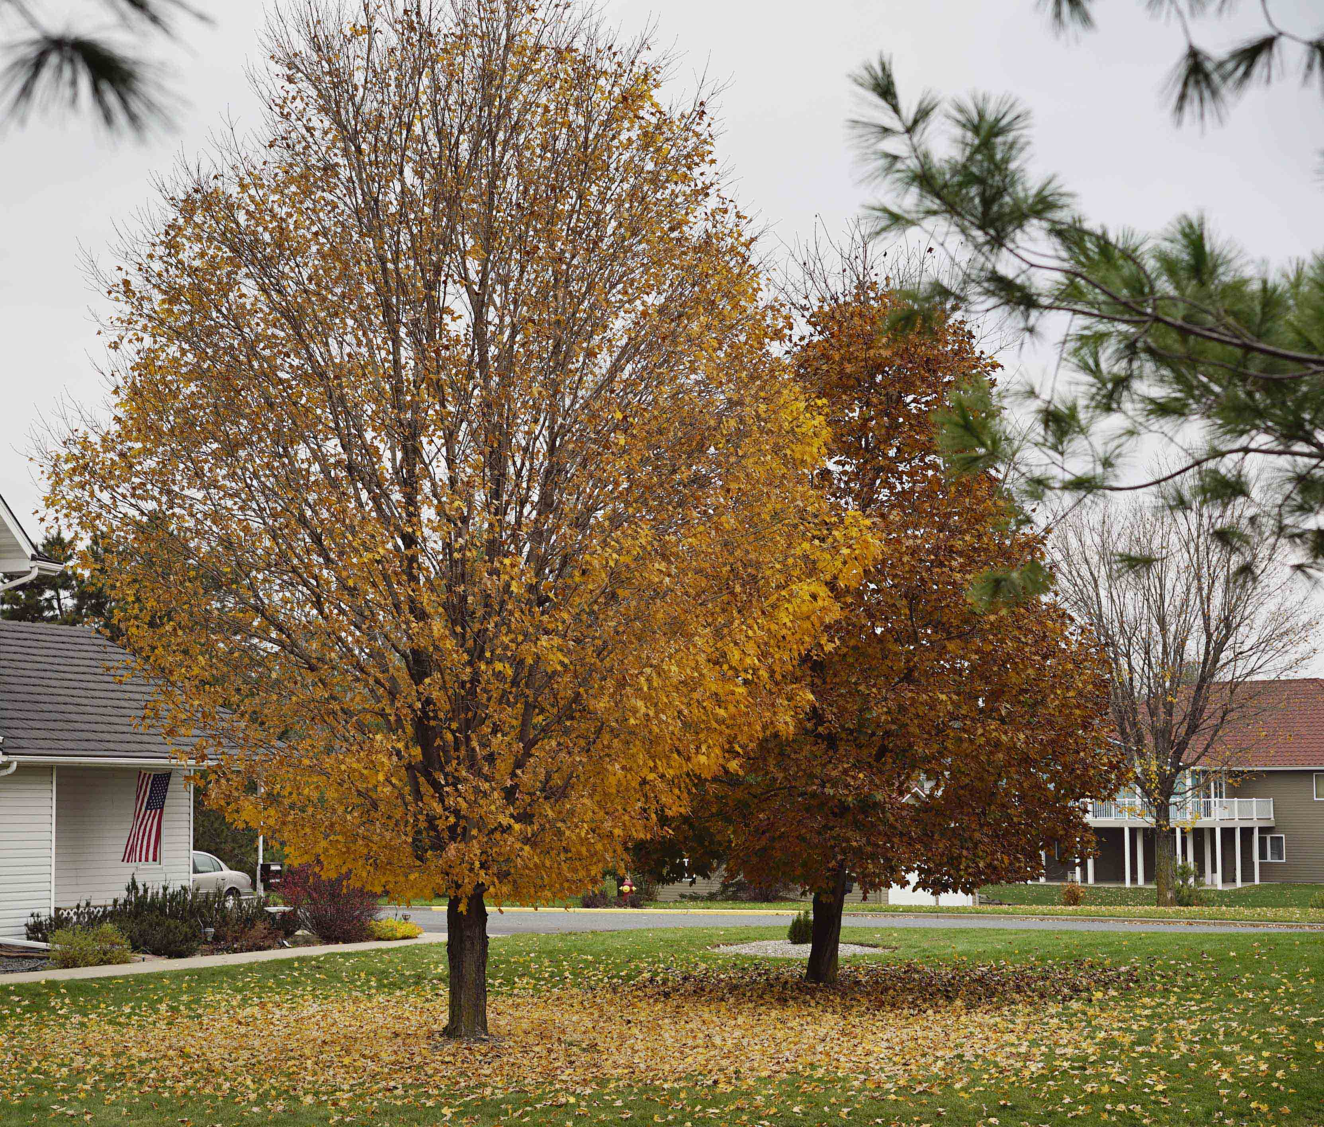
Leaf Senescence

Slide 7
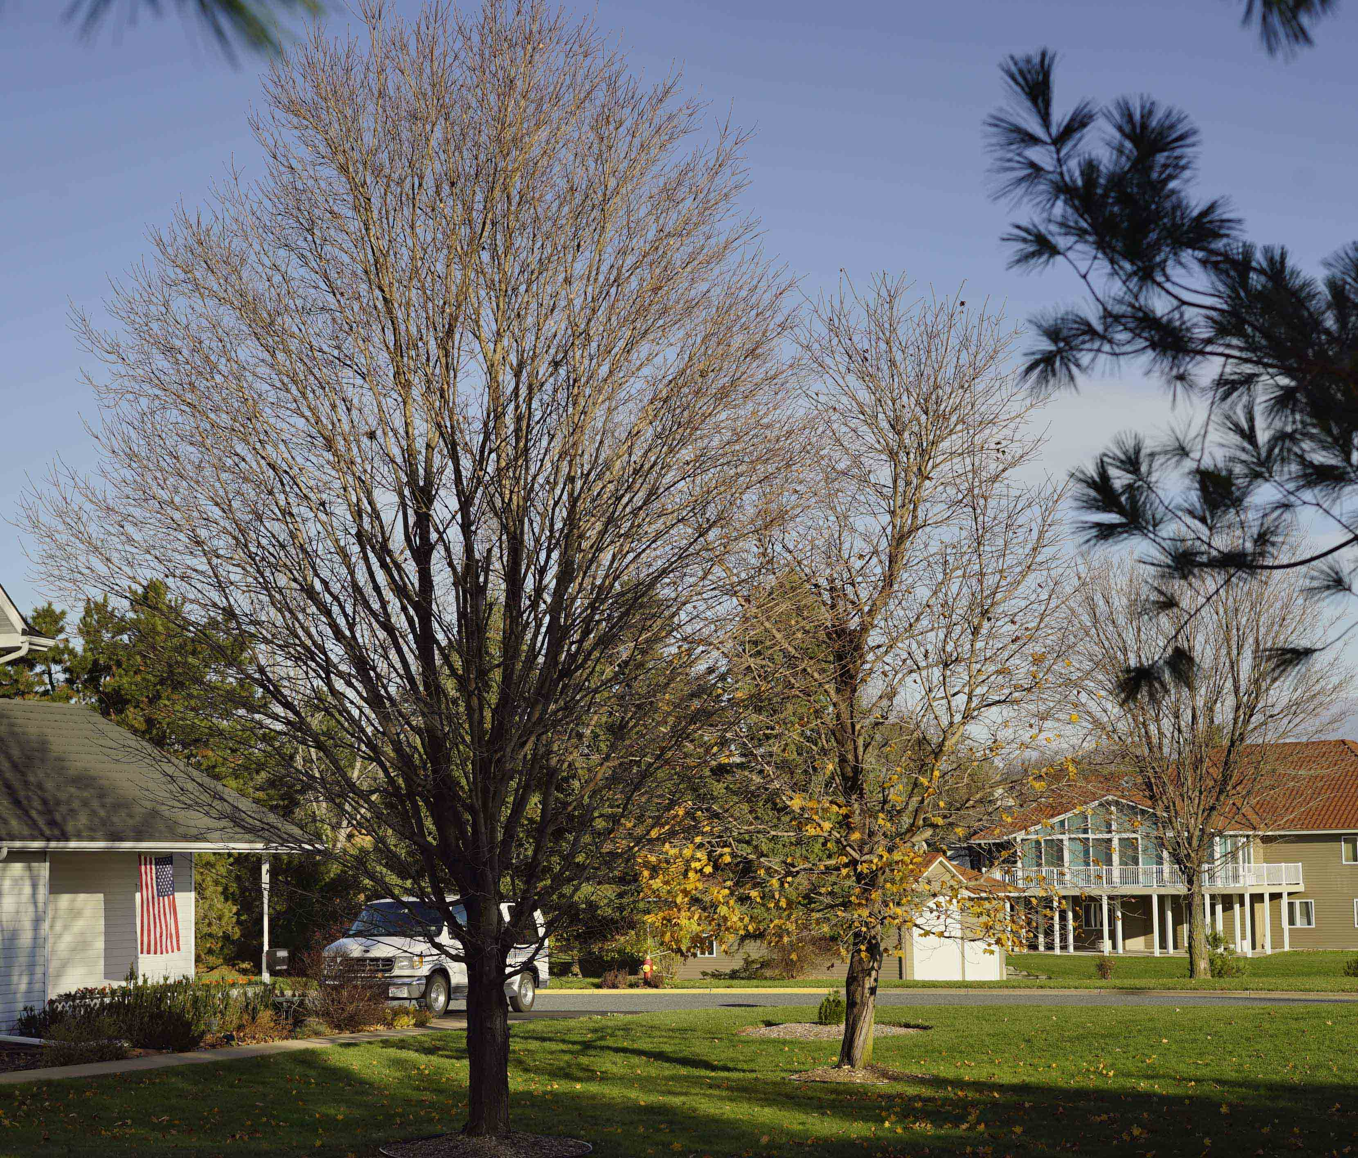
Leaf Senescence

Slide 8
Speaking of Senescence, The SoaringRx Column is getting Old
60 columns as of March, 2016
The collection: http://www.tinyurl.com/drdanscolumns
I'm taking a leave of absence at least for the season
There are simply other needs, including
my son's legacy: www.cultivate-community.org and http://www.danlj.org/eaj

Slide 9
What is Senescence?
Terminal decrepitude: what happens if we remain healthy throughout life. Nothing works like it used to. Nothing.
Cells: loss of reversible quiescence, regenerative & reparative capability (gene de-repression p16INK4a) promotes either cell involution or growth (sometimes leading to cancer)
Embryonic cells: tissues required for development senesce, die when done (tadpole's tail, umbilical cord); trigger of tissue remodeling
Damaged cells: death, clearance, & regeneration from specific quiescent stem cells
Cancer: pro-senescence cell changes invoked, arrest proliferation, & recruit their own engulfment by immune cells – unless tumor-suppressor pathways malfunction.
“age-related pathologies generally rise with approximately exponential kinetics beginning at approximately the mid-point of the species-specific life span (e.g., 50–60 years of age for humans)” - Dr. Judith Campisi

Slide 10
"The knowledge that every ambition is doomed to frustration
at the hands of a skeleton
has never prevented the majority of human beings
from behaving as though death
were no more than an unfounded rumor."
- Aldous Huxley
Many things we do accelerate aging;
Nothing has been found that slows senescence.
Examples:
- skin and bones – vitamin D
- slowly toxic processed food

Slide 11
Accelerated Aging

Slide 12
Vitamin D

Slide 13
What's Good about the Mediterranean Diet? Really it's Crete, not France or Italy or Morocco...
Its components are synergistic cardiovascularly
Minimize animal fats, espcially cooked fat
Substitute olive oil & nuts for fats and refined sugars
Replace baked treats with many servings of fruit and vegetables daily
Replace refined carbs with whole grains
Eat snack-sized meals
Legumes are important for protein, for vegans (nuts are more healthful, in palmful servings)
(Eat food, mostly plants, in moderation.) (Appetite is wrong – obesity, sugar stimulate hunger)

Slide 14
Prevent and Reverse Heart Disease

Slide 15
It is possible to reverse heart disease
This requires a strict, low-fat vegan diet with vitamin B12 and vitamin D supplements
There are wide differences among individuals:
Jack Spratt could eat no fat; His wife could eat no lean. And so, between them both, you see; They licked the platter clean.
About 1/3 of people have “prediabetes”, which is accelerated by refined fructose & sucrose, and by fat and oil.
The “lipid profile” and fasting blood sugar can profile individual needs for diet and activity change.

Slide 16
Cookbooks

Slide 17
Our Insanity: Pills vs Discipline

Slide 18
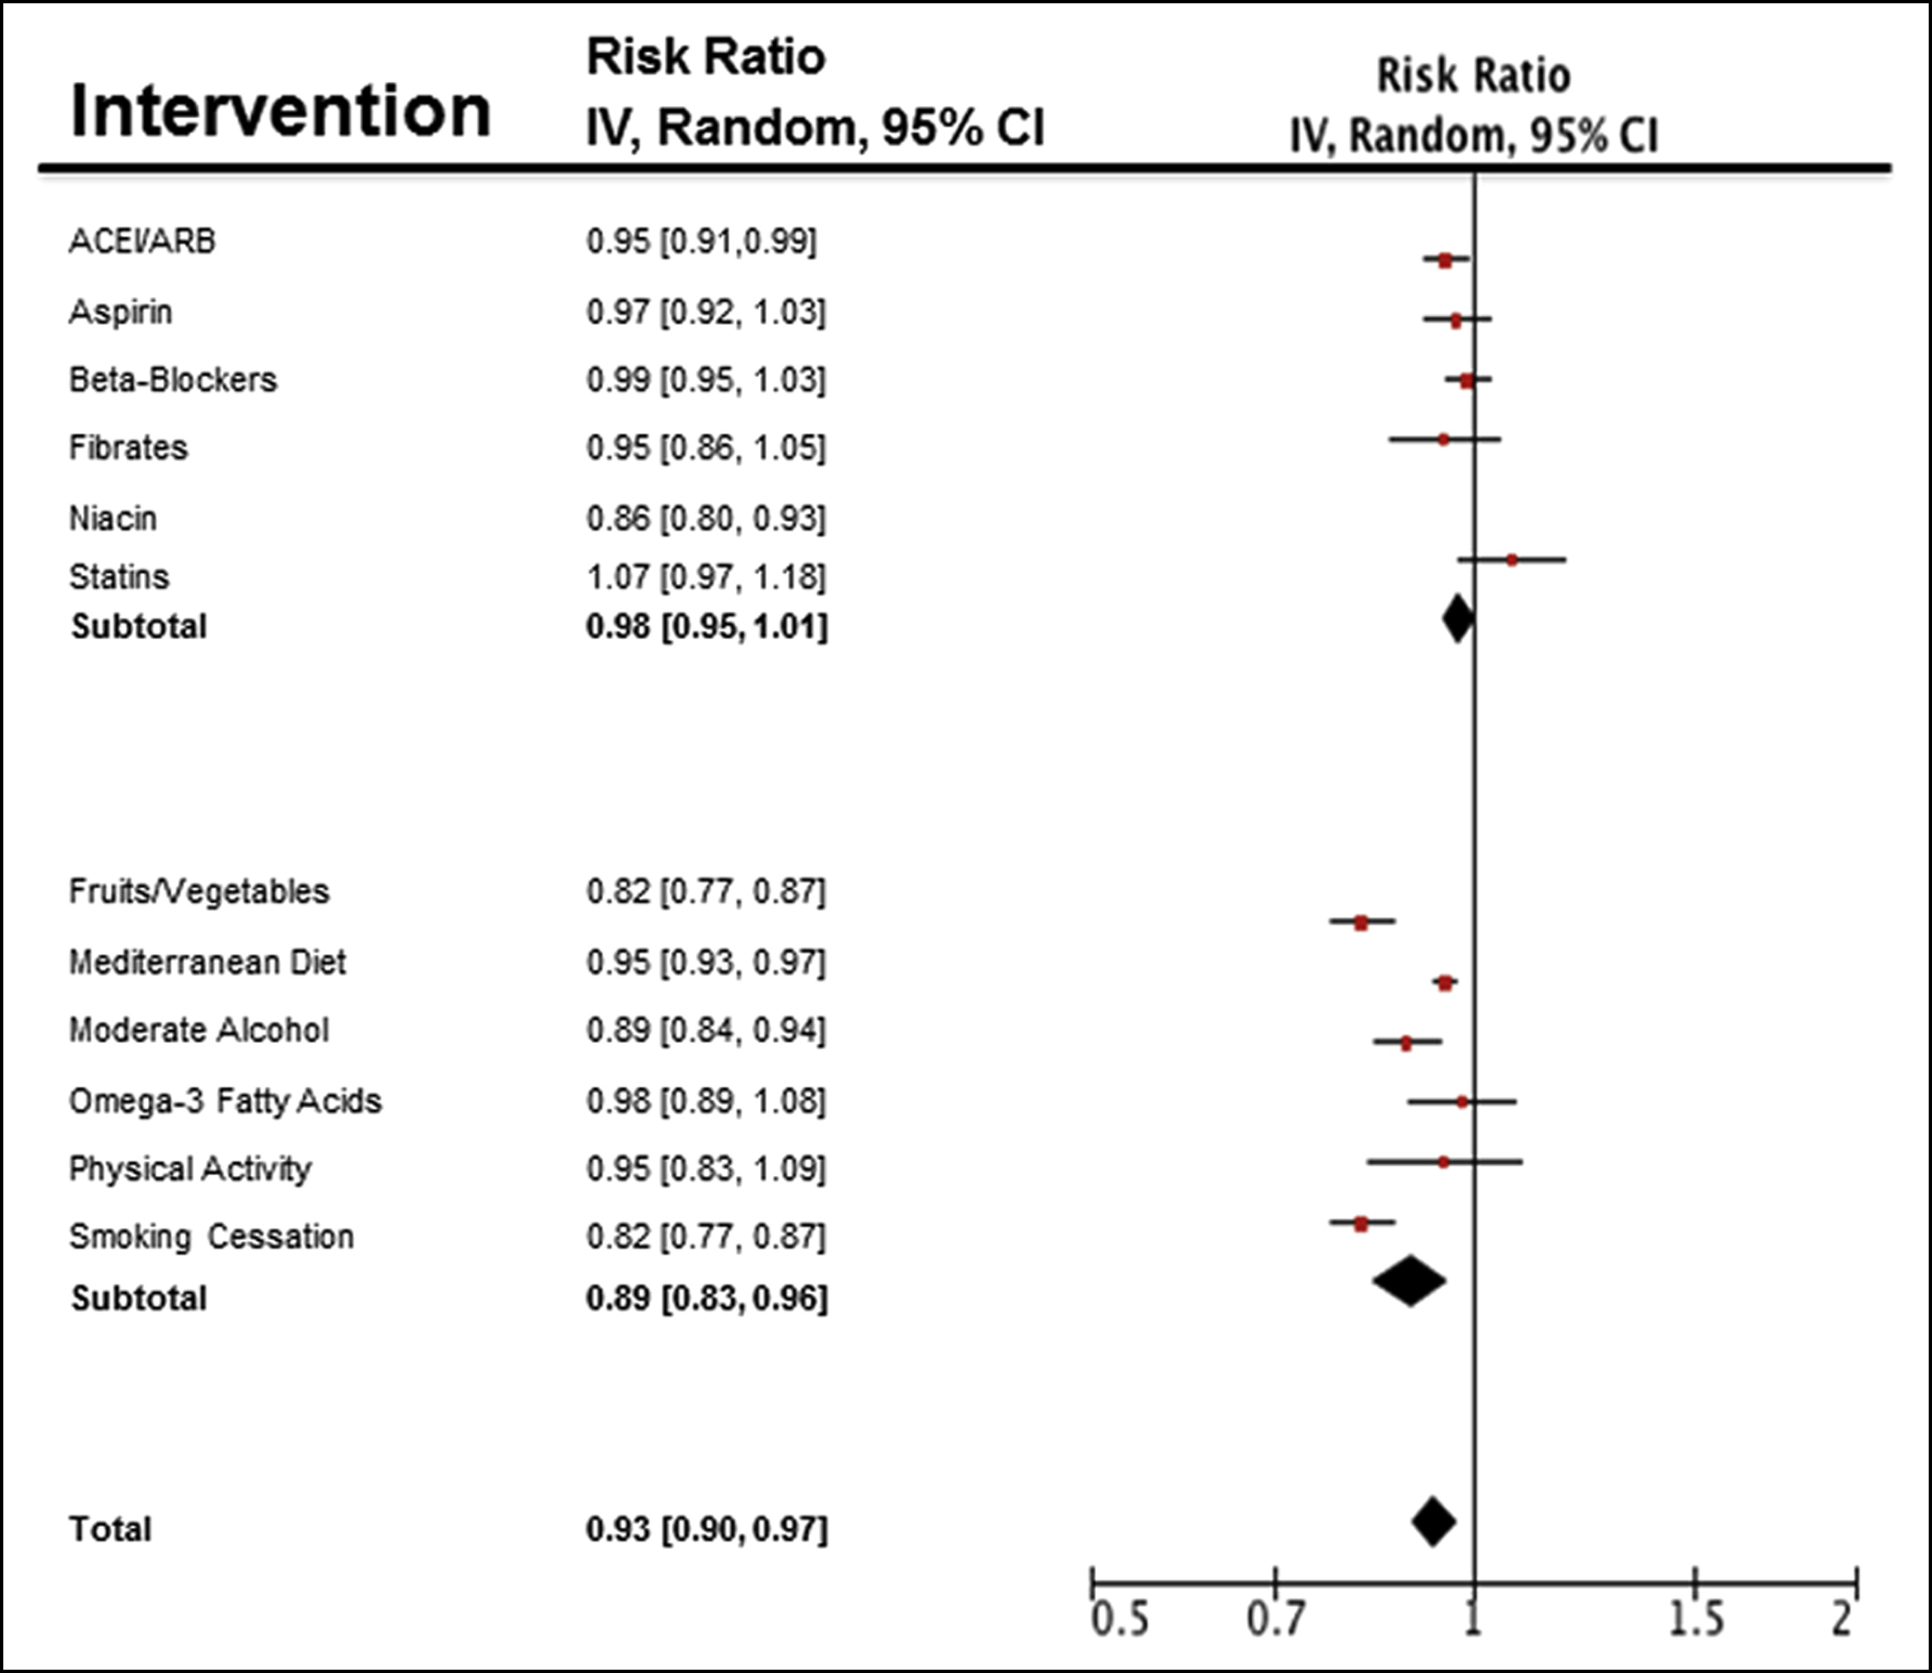
The Relative Benefit of Pills

Slide 19
Health in a Nutshell
Eat Food, mostly plants
Minimise oil/fat
Eschew cooked fat, especially cooked animal fat
“Ah don't eat fat; it wars with the stomach” – Satchel Paige
Avoid manufactured food
Fructose, sucrose (glucose + fructose)
Sodium load
Lean protein
Eggs > fish > fowl > game > pork/mutton/beef
Don't inhale any kind of smoke
Live life with others:
Exercise
Feel loved
Join groups (fly a tandem glider)

Slide 20
Pushing Senescence Away

Slide 21
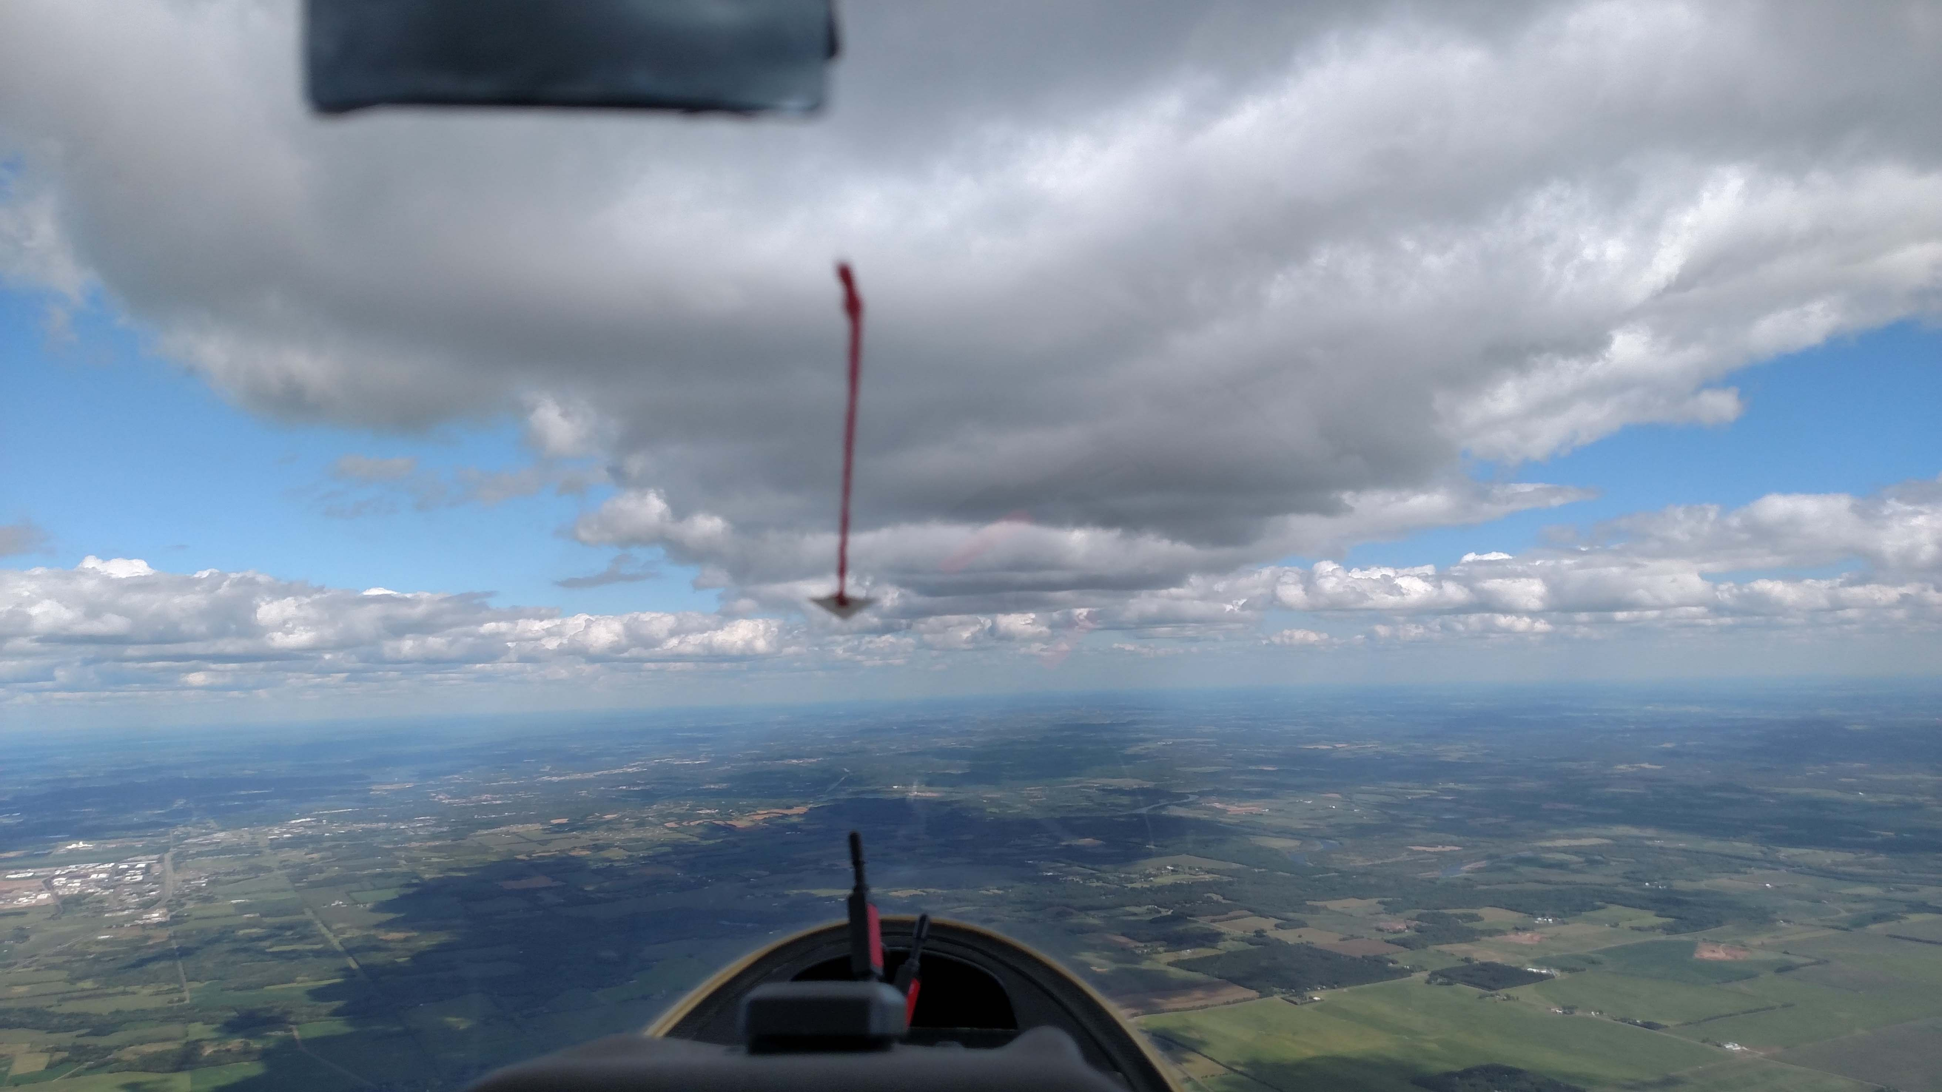
A Form of Happiness

Slide 22
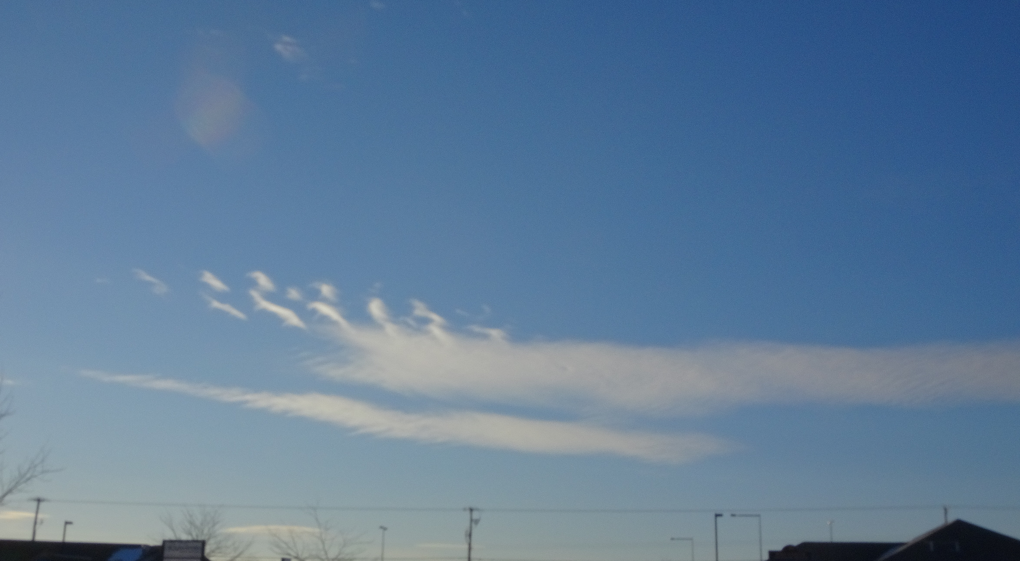
Atmospheric Waviness Over the Prairie
Wave is everywhere
Not all wave is soarable
There's more than you think
It's often evanescent
The atmosphere is a stack of vast leaves of air moving across each other
Different density (temp, humidity)
Different lapse rate
Different speed
Where there's difference across a boundary, there is wave.

Slide 23
Types of periodicity
Stable: no wave; laminar flow, eddies damp out
Shear wave: periodicity due to difference of wind speed across a boundary (of density, humidity, temperature, velocity)
Thermal wave (streeting)
Strongly affected by wind velocity and instability.
Convection wave: periodicity enhanced by thermal penetration from lower layer to upper
Strongly affected by instability of lower and stability of upper layer.
Convective wave vs convective rolls
Convective roll = “morning glory” in Australia, post-coldfront rows

Slide 24
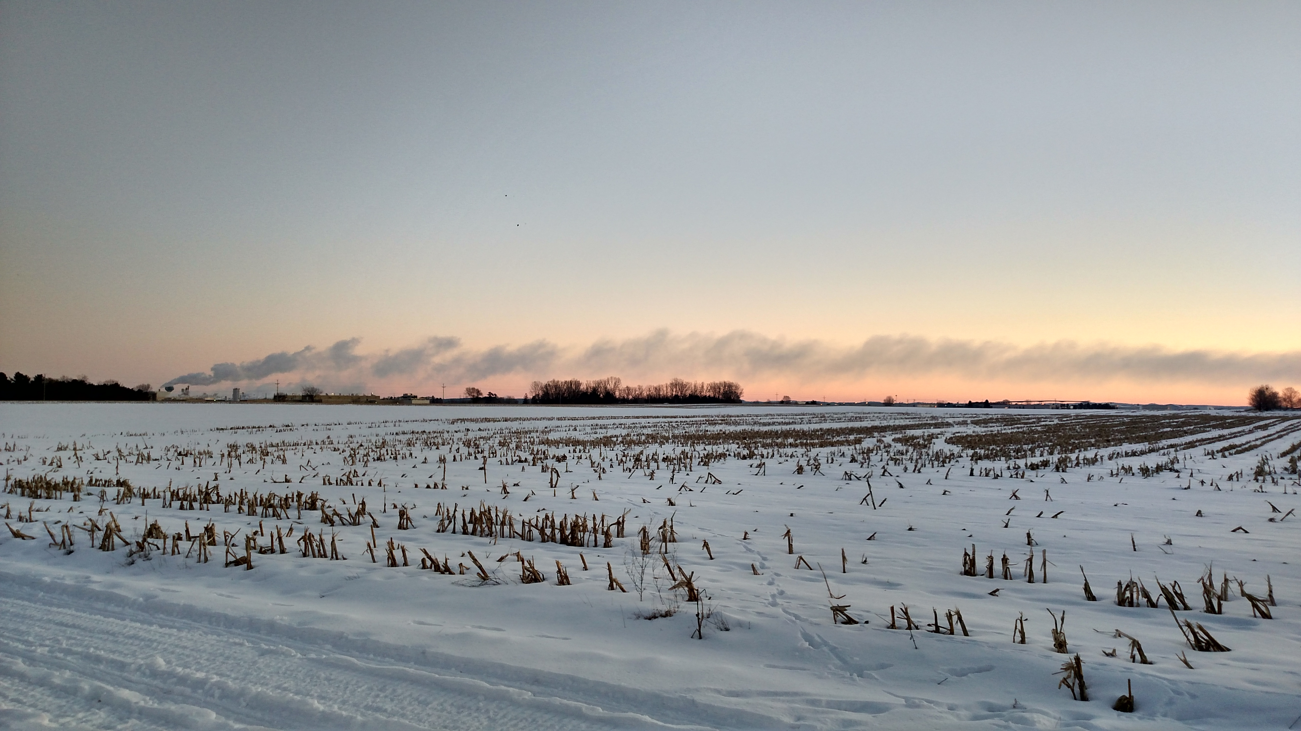
Non-Wave – no nocturnal inversion, stable

Slide 25
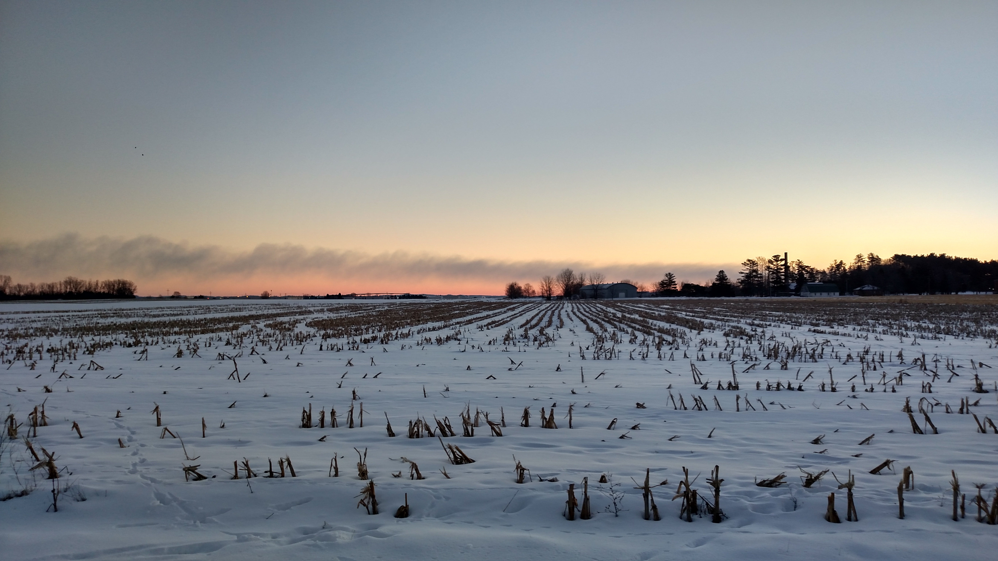
@ -12F/-20C water turns to dust... Stable flow turns laminar if it can...

Slide 26
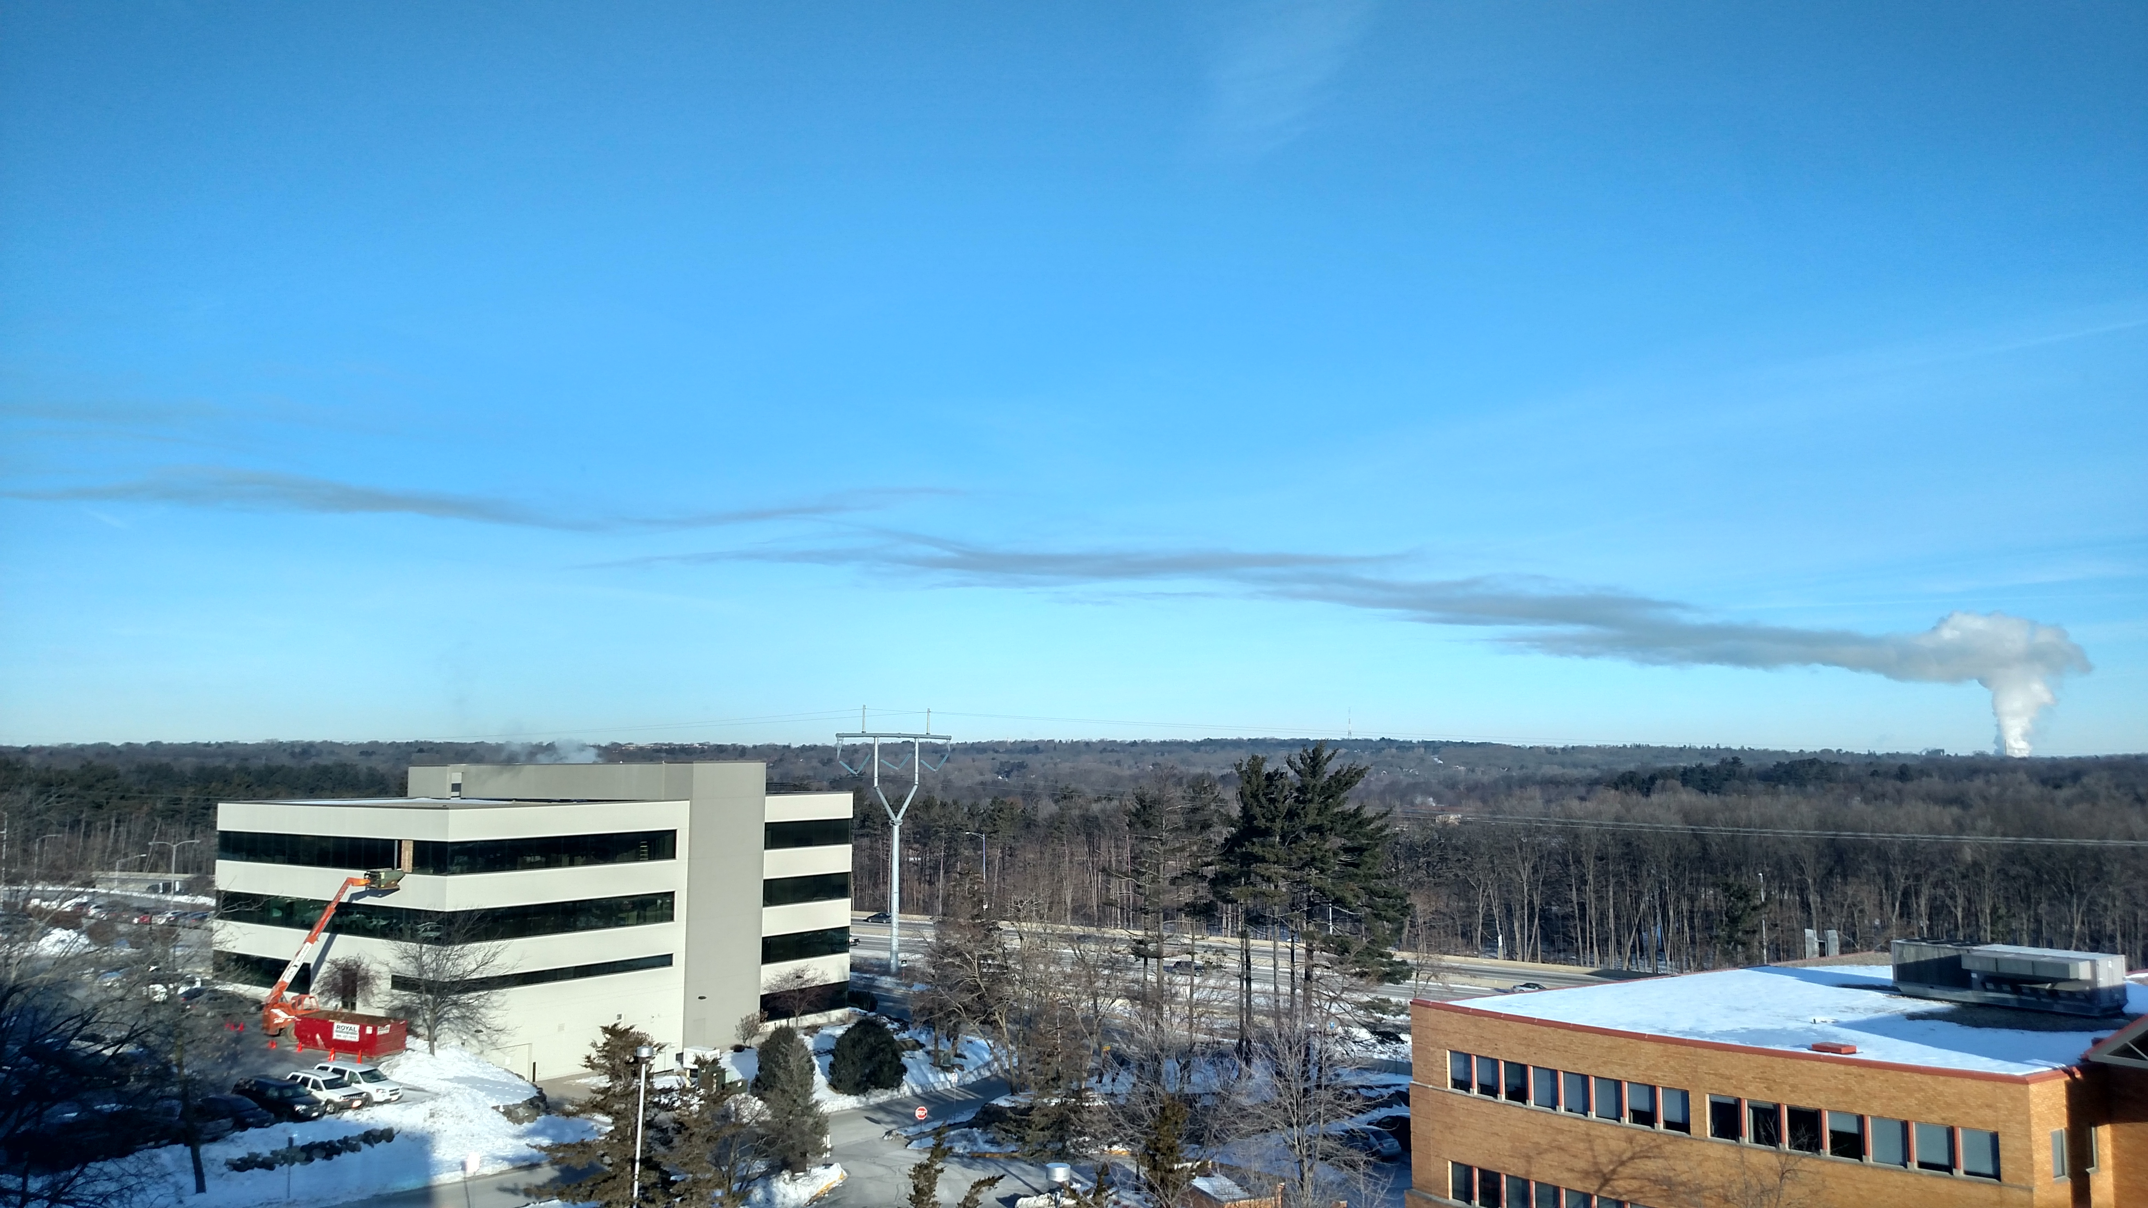
Shear Wave 0F / -14C, nocturnal inversion, slight shear

Slide 27
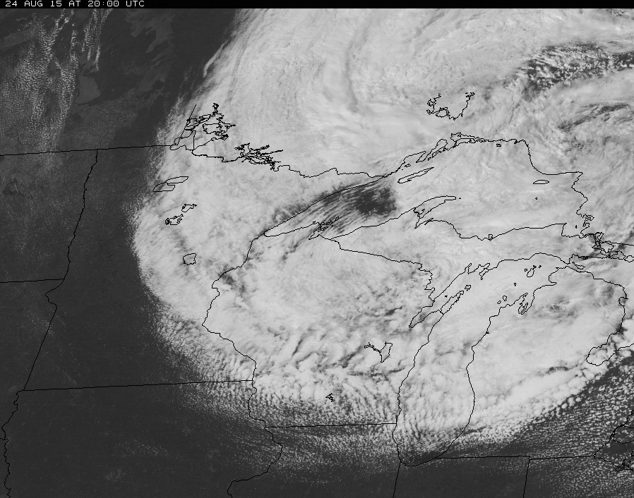
Lee Wave

Slide 28
Thermal Wave
Any fluid flowing across a boundary bounces.
Shear can be speed, direction, or density … or all
Thermals begin in an “unstable” layer and cross the boundary atop it.
Thermals penetrating the shear boundary are an obstacle to laminar flow and
Amplify the bounce within the stable layer above
(If the layer above isn't stable, we get Cu-nim instead of thermal wave)
If streeting occurs in the boundary layer,
Shear wave may align the streets or
Cross the streets (creating a checkerboard of cu, pretty rare)

Slide 29
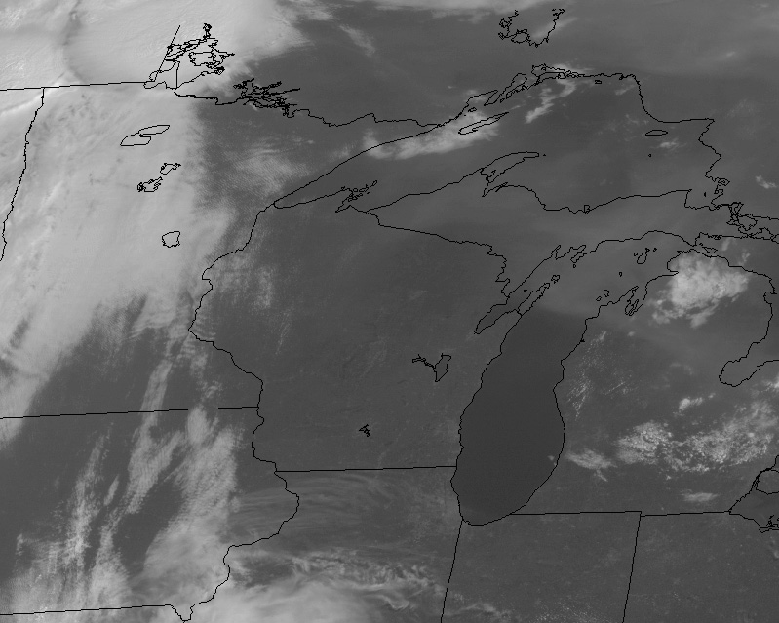
Wave d/t southerly flow ahead of a cold front

Slide 30
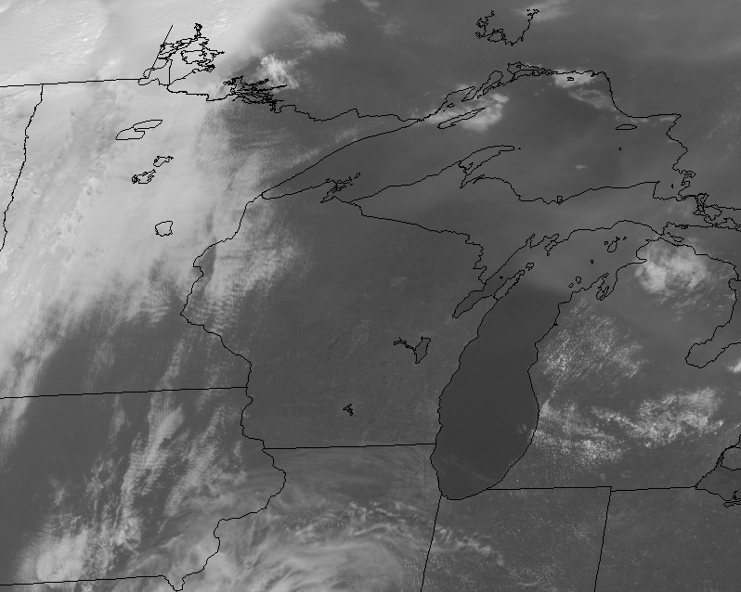
August 22, 2015

Slide 31
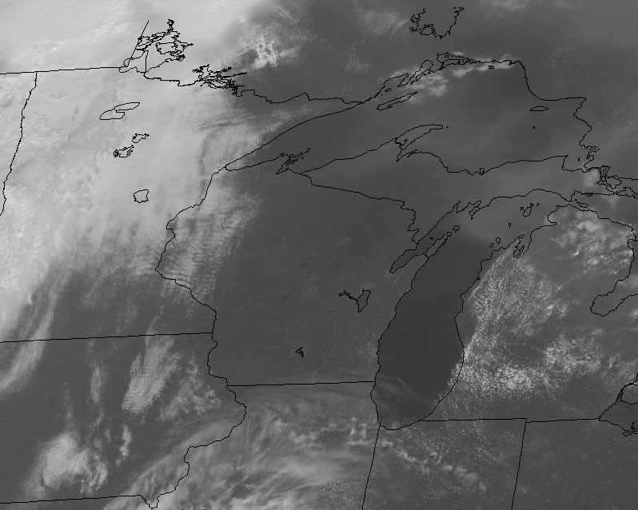

Slide 32
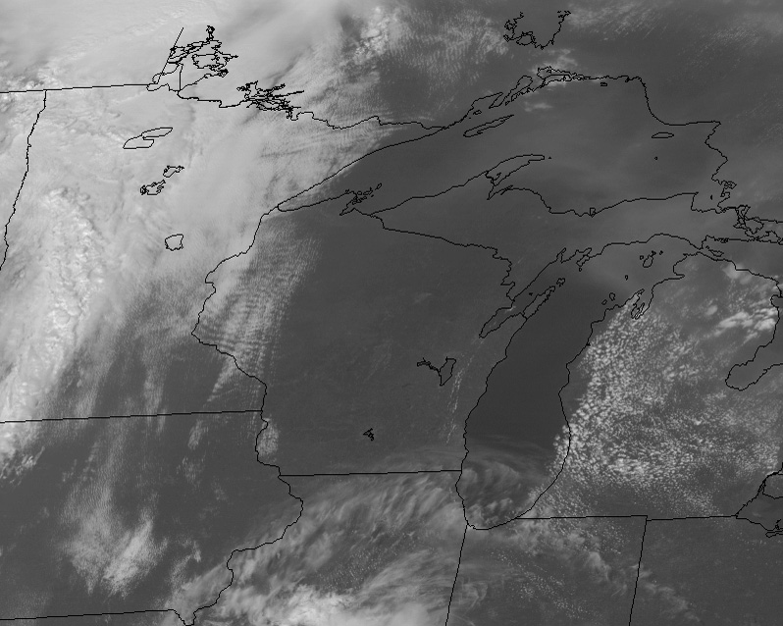

Slide 33
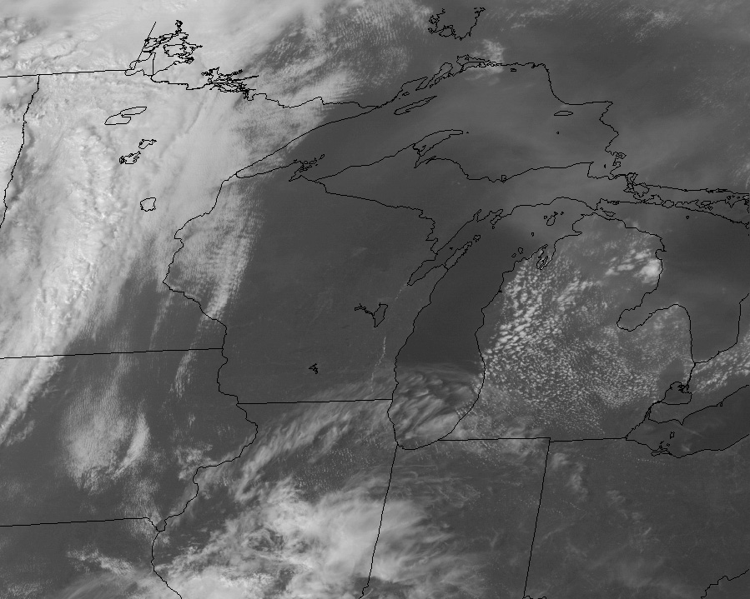

Slide 34
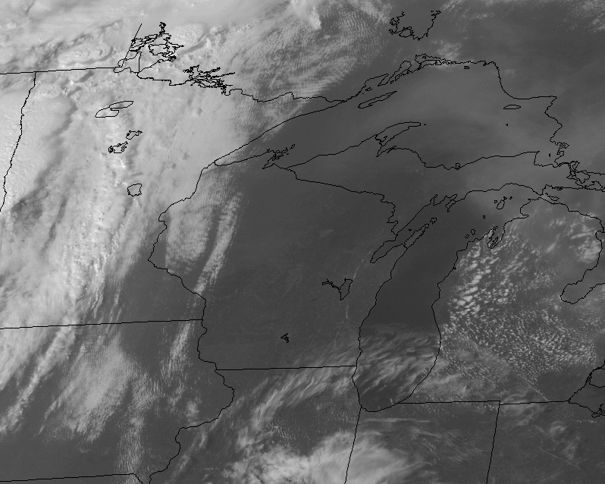

Slide 35
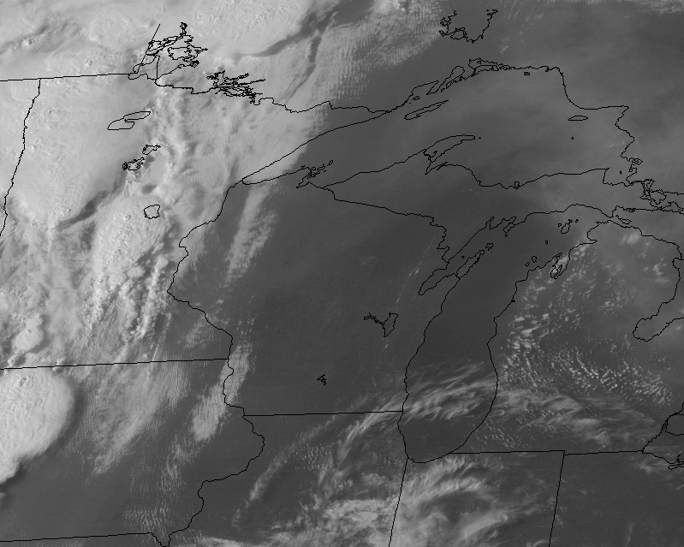

Slide 36
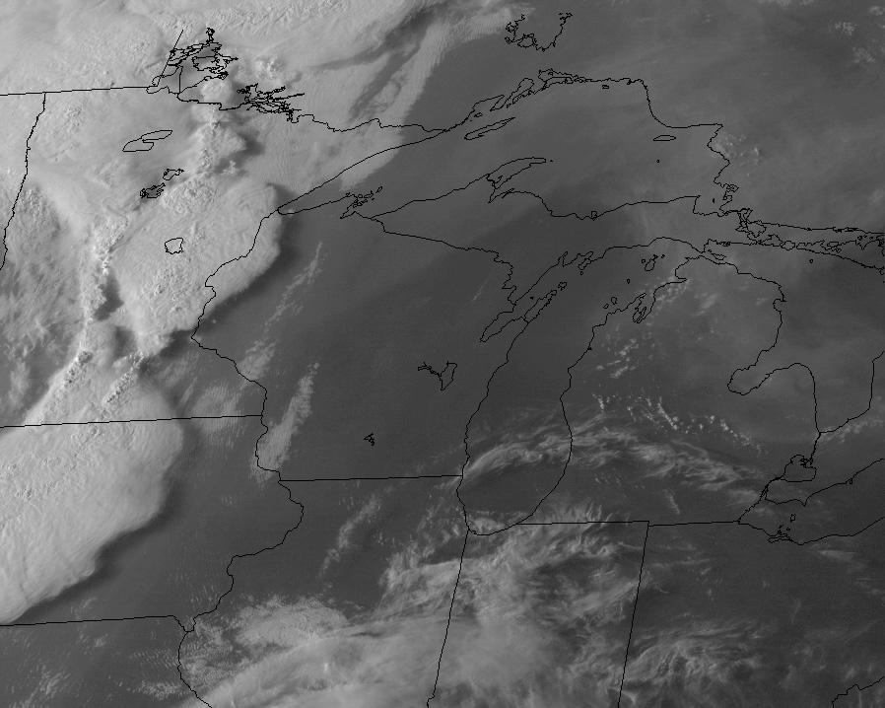

Slide 37
Pileus Cloud: Thermal wave as a cap over Cu

Slide 39
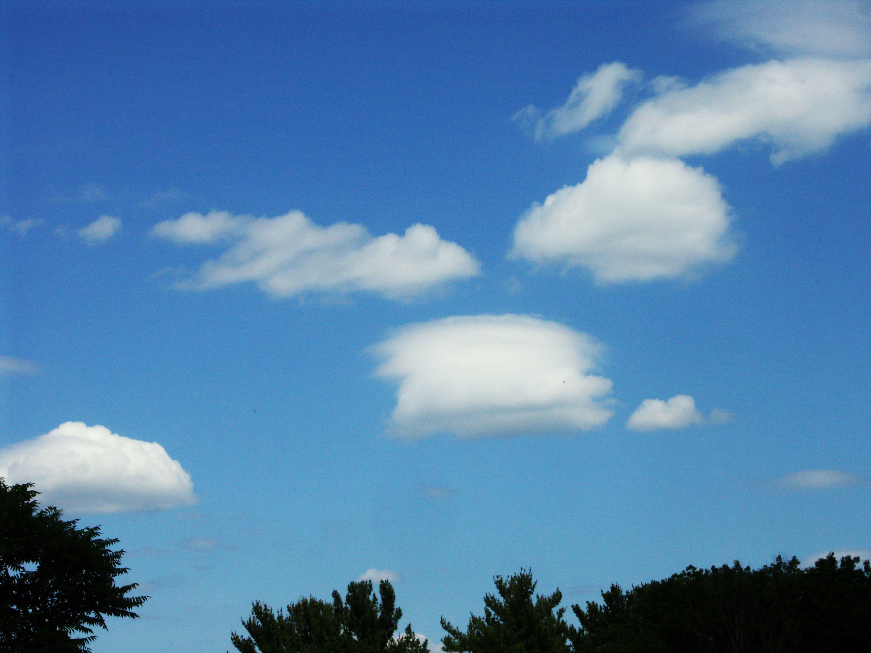

Slide 40
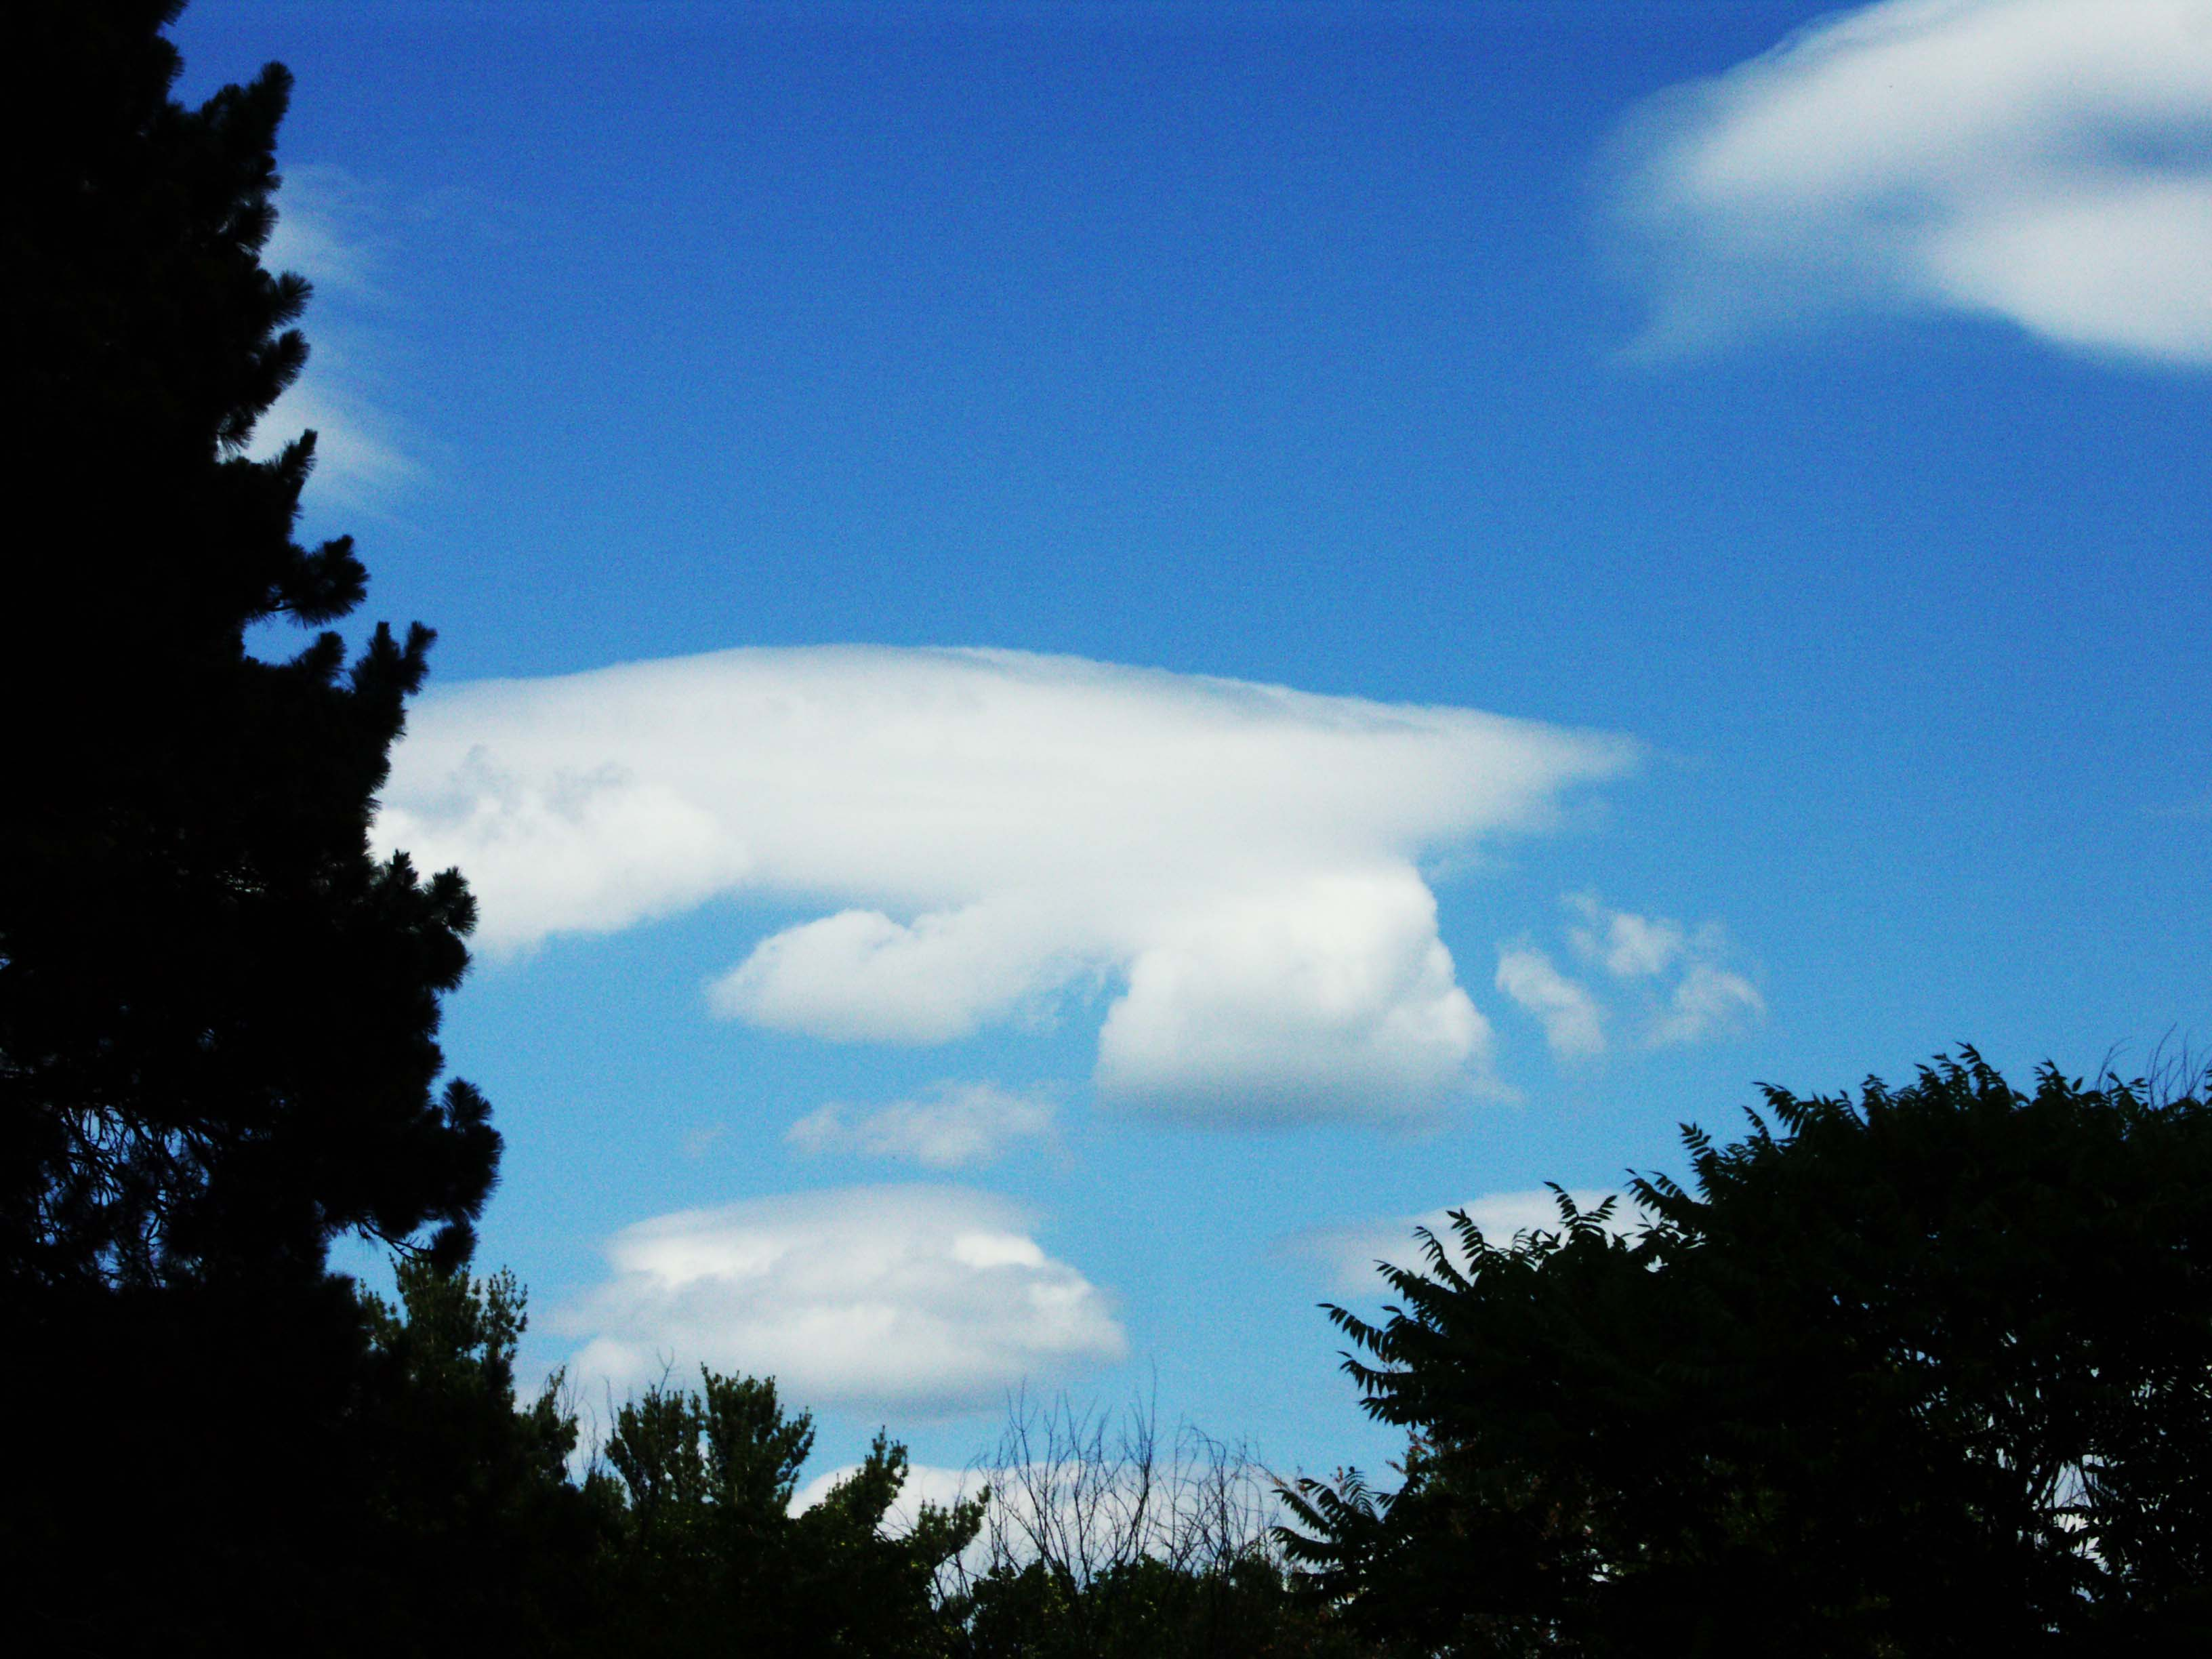

Slide 41
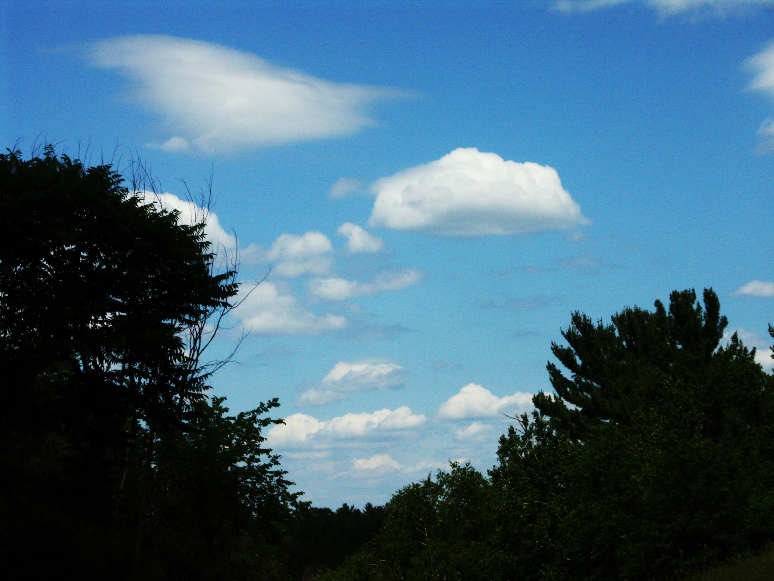

Slide 42
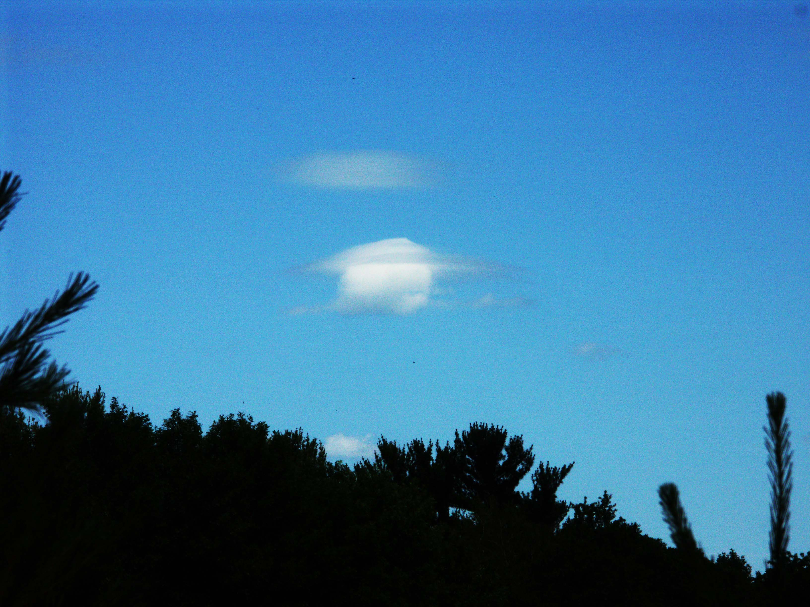

Slide 43
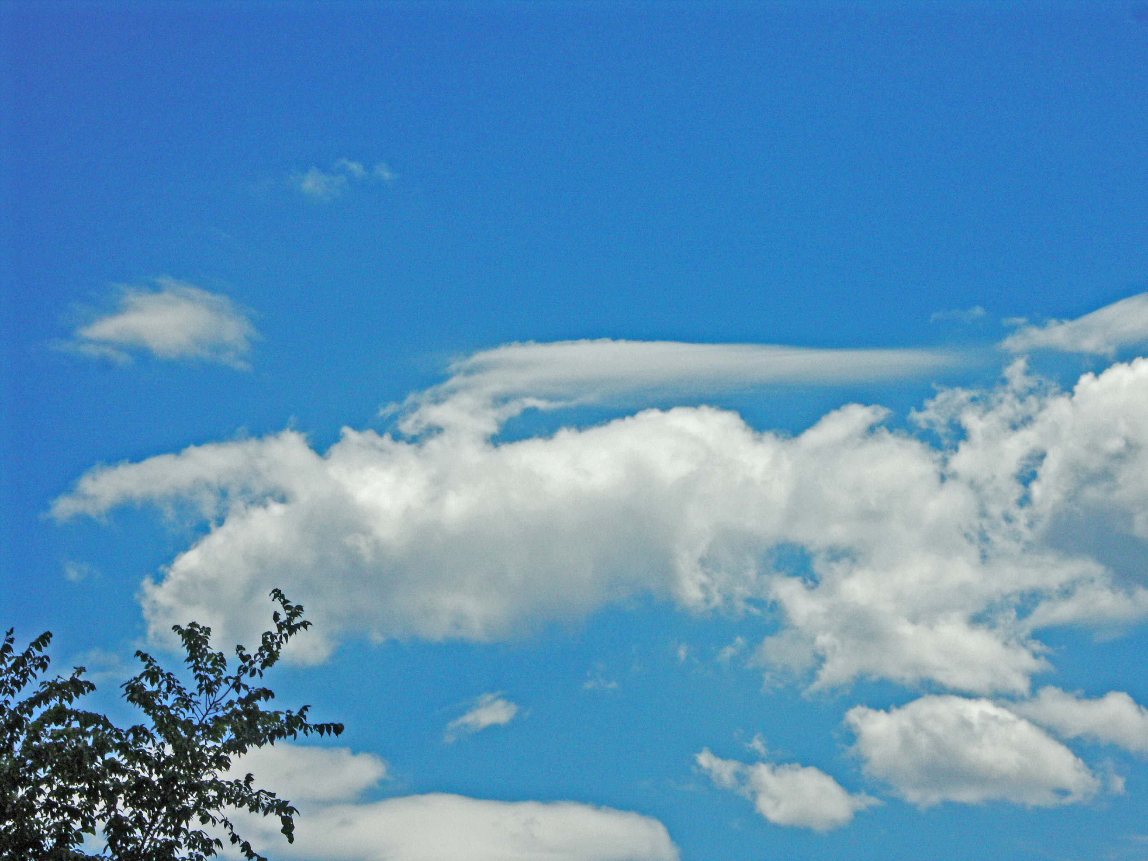

Slide 44
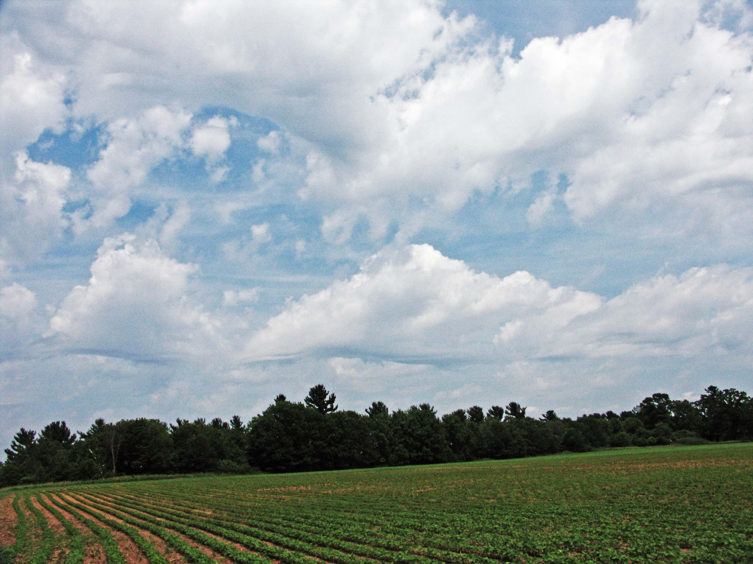
Wavy Bases – Shear wave altering the boundary

Slide 45
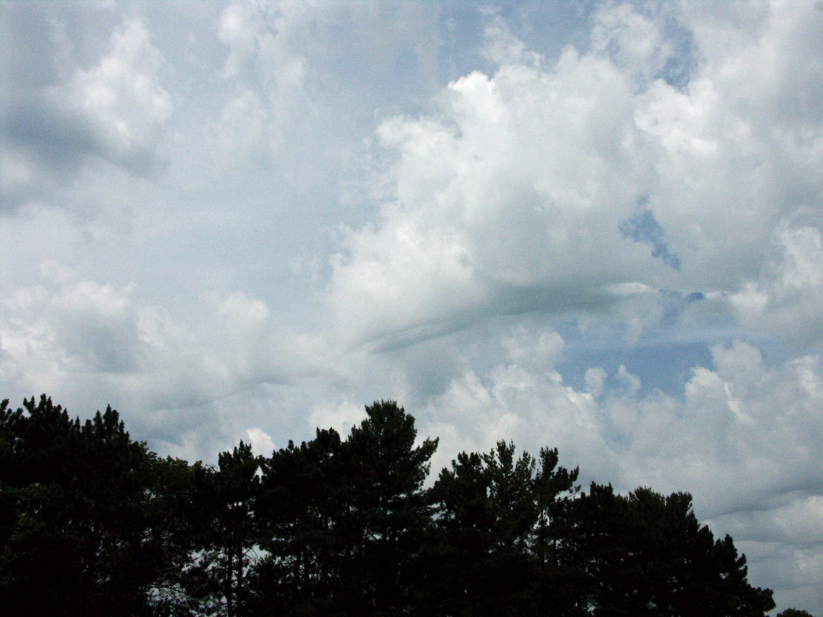
Conditions: - Near center of low, cold front nearby west (left) - Boundary-layer winds 160-180 @ 14-17 kt - Upper-layer winds 260-290 @12-14 kt Uniqueness: condensation above wave boundary Not a stable system: small scale, evolved very rapidly Cirrus shown is blown off cold-front Cu-nim

Slide 46
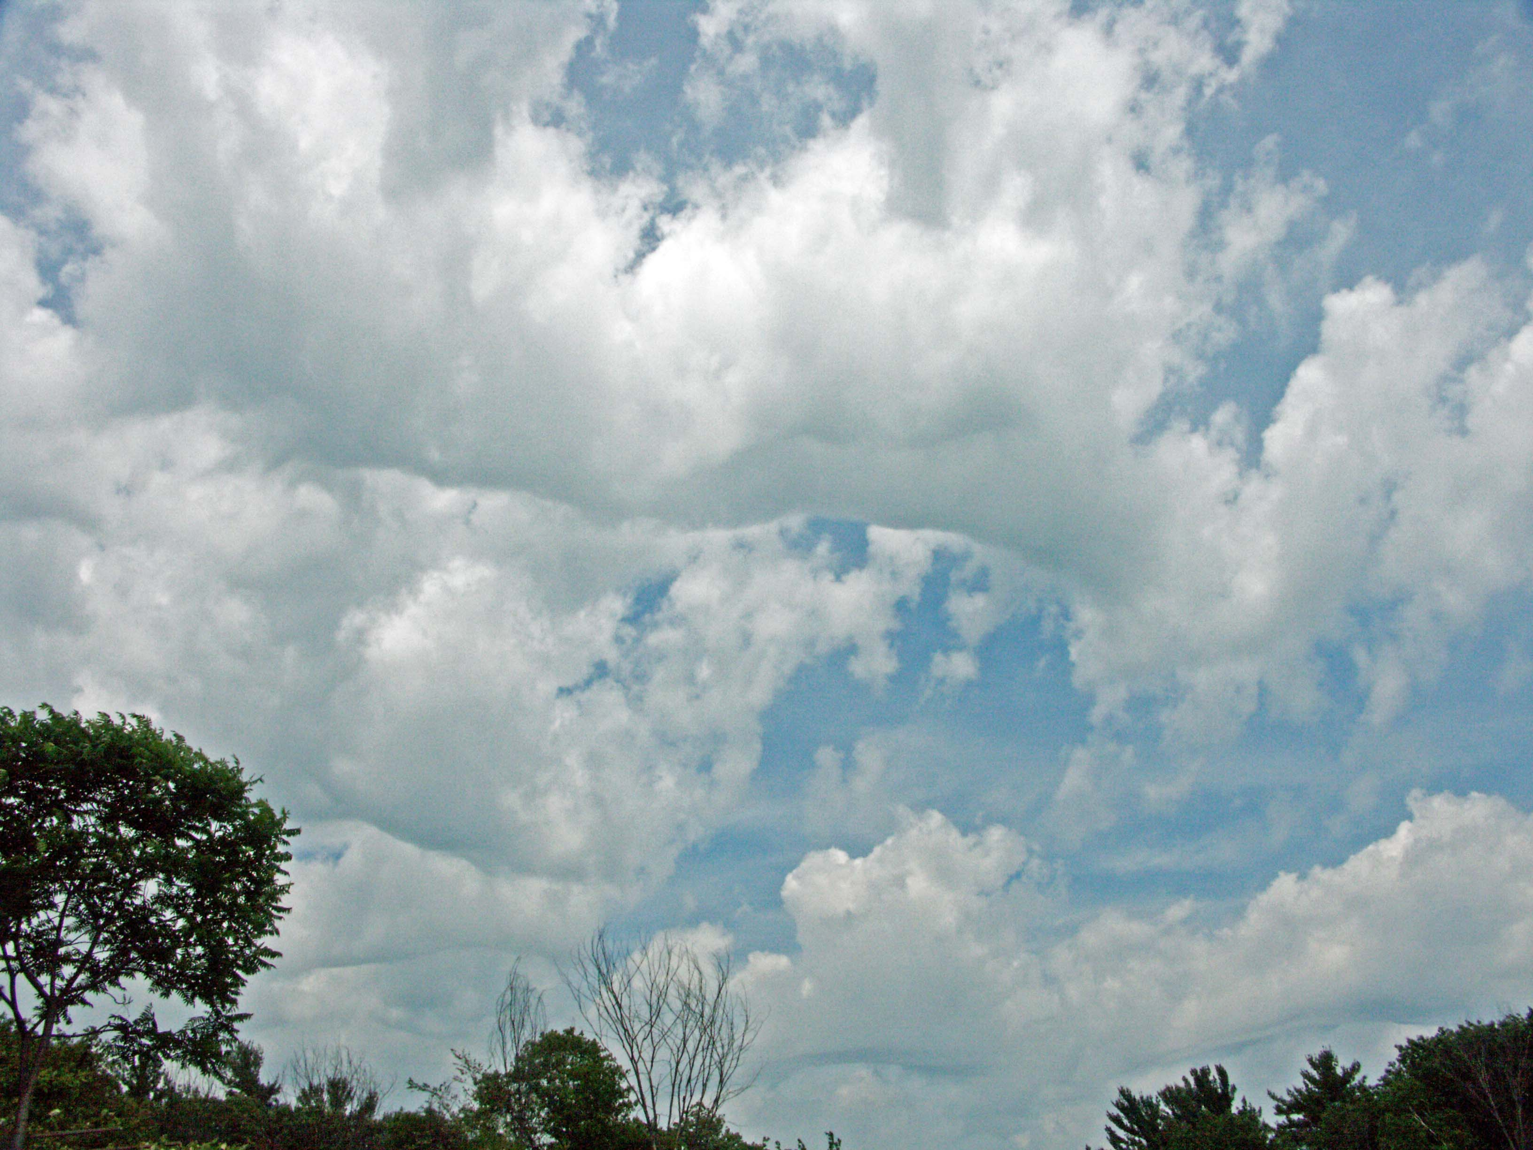

Slide 47
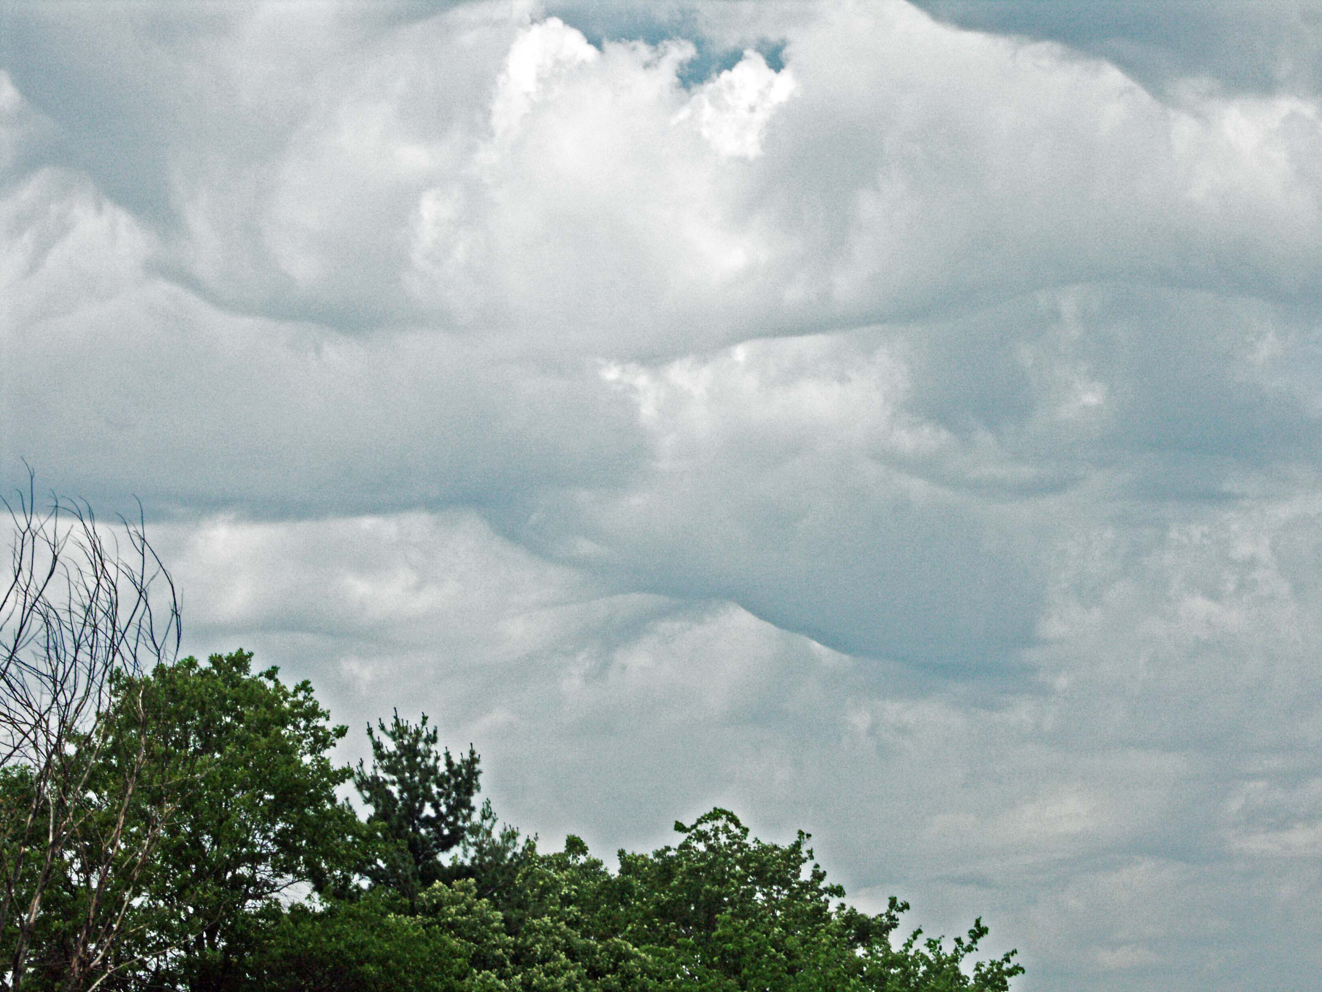

Slide 48
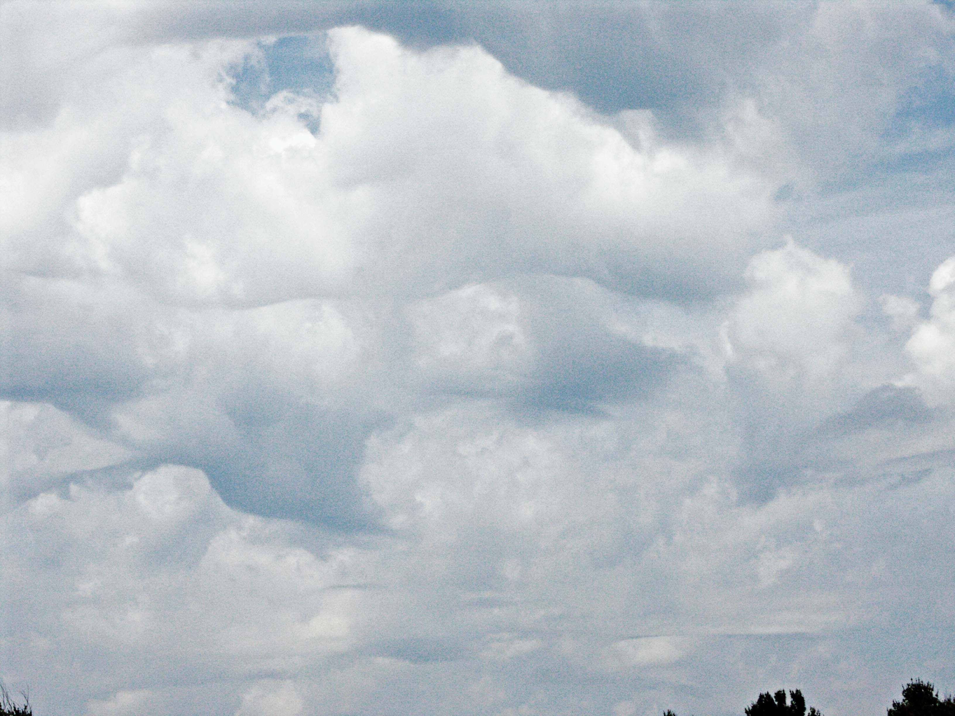

Slide 49
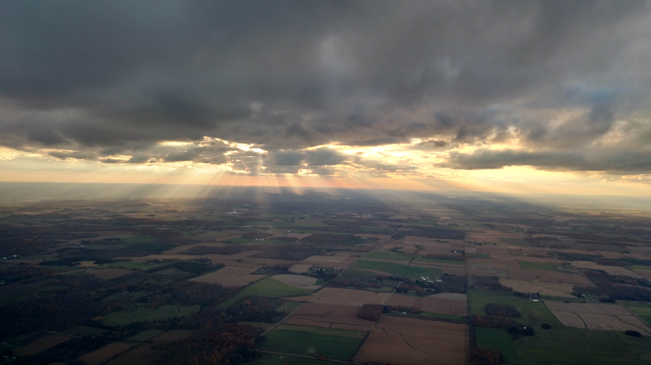
Overdeveloped “streets” are wave

Slide 50
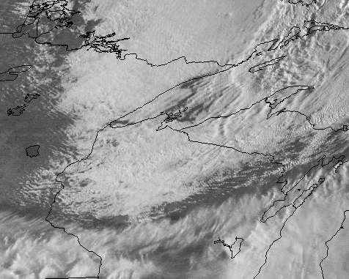
Correlative sat image

Slide 51
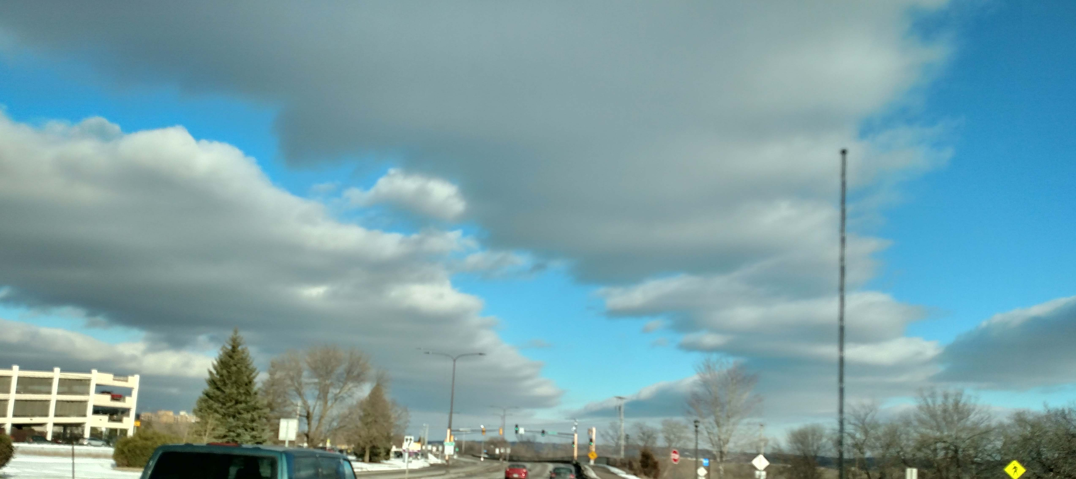
Post-coldfront wave or convective roll

Slide 52
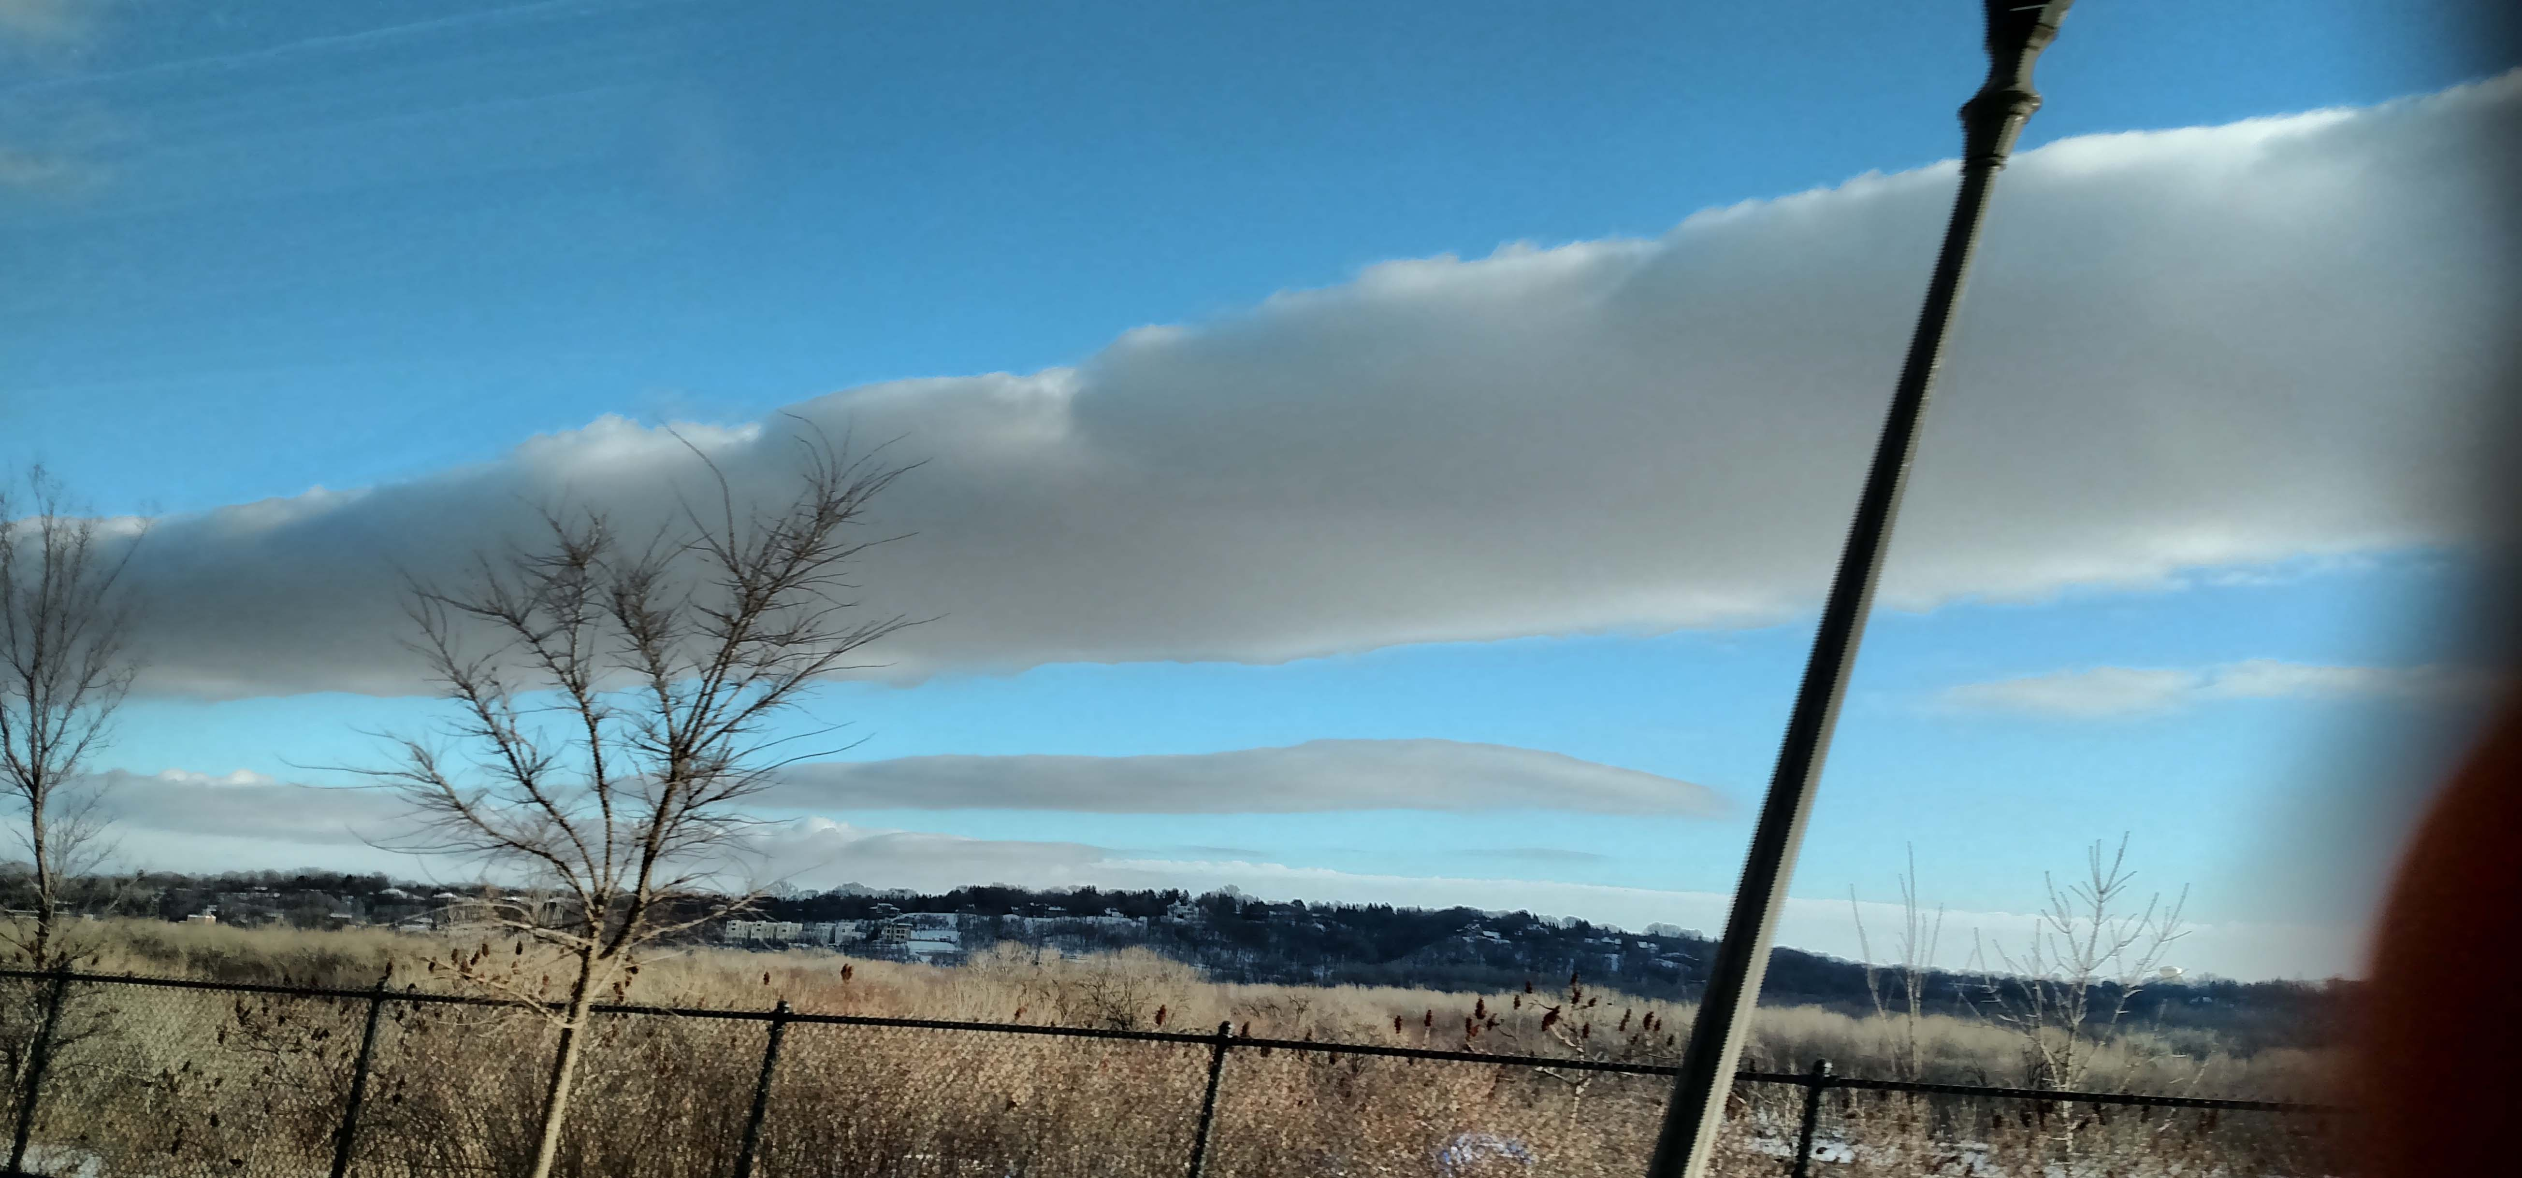
Winds ~350 @ 25 kt up there

Slide 53
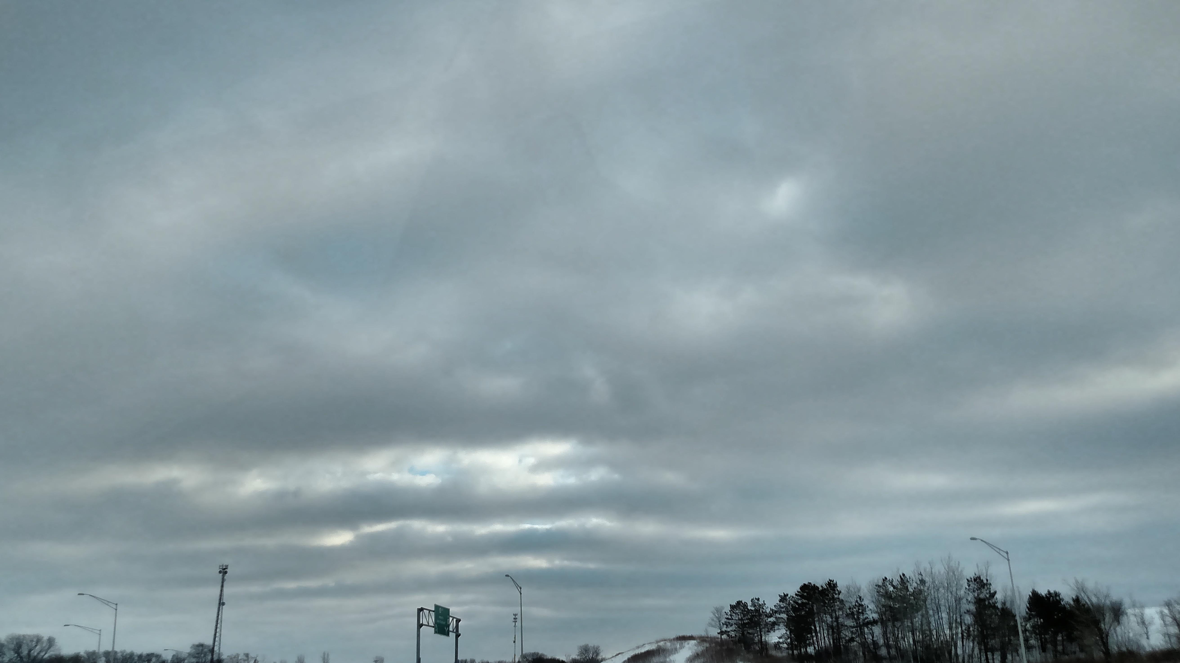
A bit further east... “overdevelopment”

Slide 54
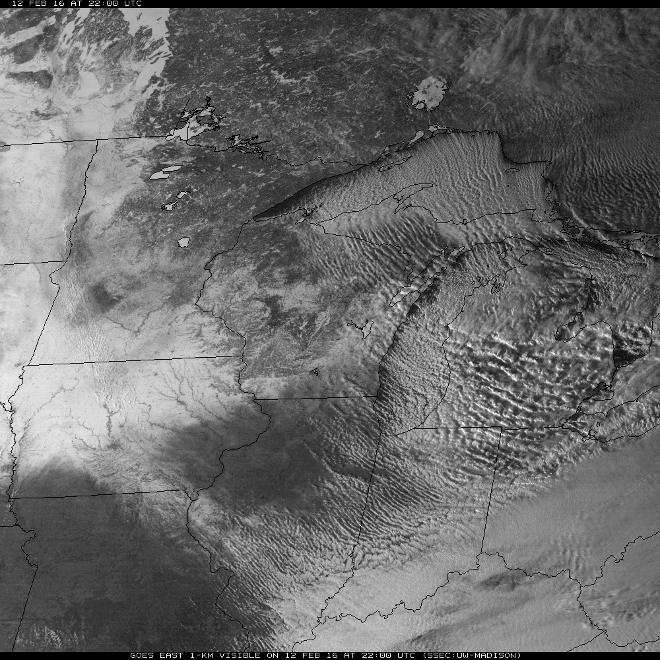
Streeting Fri 2/12/16 – Winter but not Wave

Slide 55
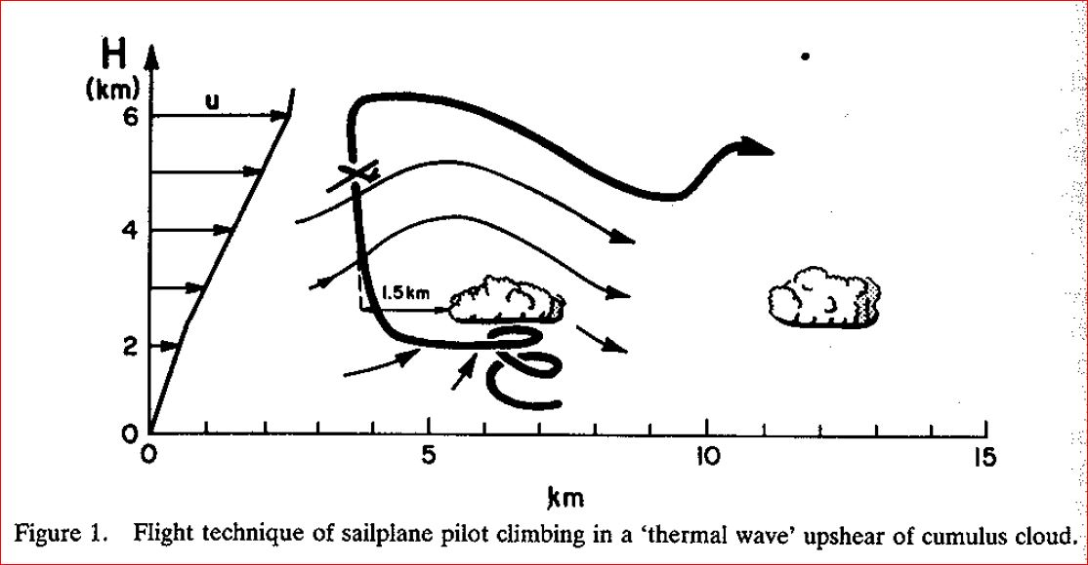
Convection wave characteristics (Kuettner, 1986)
“You get up all the speed you can under the cloud, then shoot up through the upwind edge.” - Anon.

Slide 56
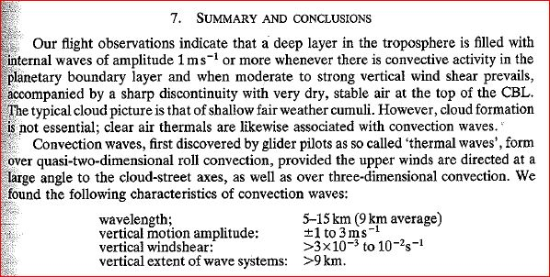
Kuettner, et al, flights 1984-5 J. R. Meteorol.Soc. (1987), 113, pp. 445-467

Slide 57
Convective-Wave Flights
May 16, 1993: Northern IL Soaring Contest, Hinckley, IL
April 24, 1998: Jack Steen/Rich Mozer, Dave Nelson, Michigan
Sept 12, 2003: Bob Faris, Nebraska
May 3, 2014: Don Gurnett, Iowa
May 10, 2014: Ted Clausing, Wisconsin
September 14, 2014: Ted Clausing, Wisconsin

Slide 58
May 16, 1993: Northern IL Soaring Contest, Hinckley, IL
Soaring Magazine, February, 1995, p 33-35 Rudy Kunda & Michael Shakman
“Ted Clausing, flying in wave over Southern Wisconsin, experienced some of the best lift, up to 4 knots through 14,000 feet. He thought the wave was several miles in length. He also experienced greater than expected sink between areas of lift. While Jagr, Vredenberg, Clausing and others were flying the wave, pilots in the convective zone below them were experiencing strong thermals, often over 700 feet per minute.”
This seems typical – convective-wave lift about half the maximum thermal strength in the convective boundary layer below.

Slide 59
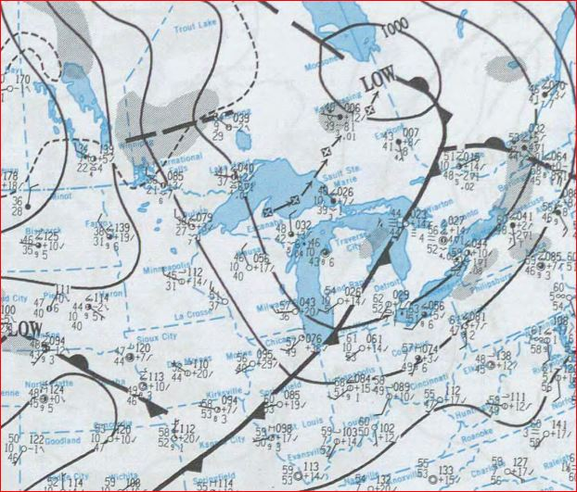
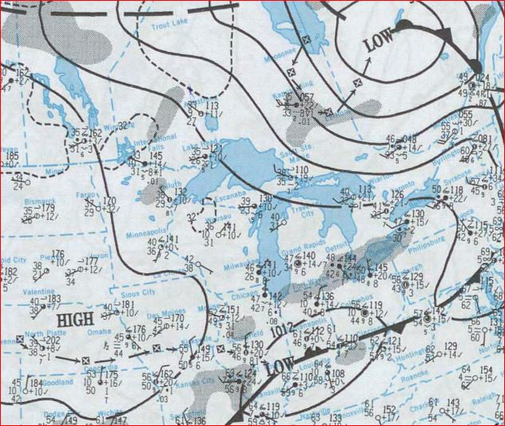
May 15 &16, 1993, weather maps
(No sounding data is available)

Slide 60
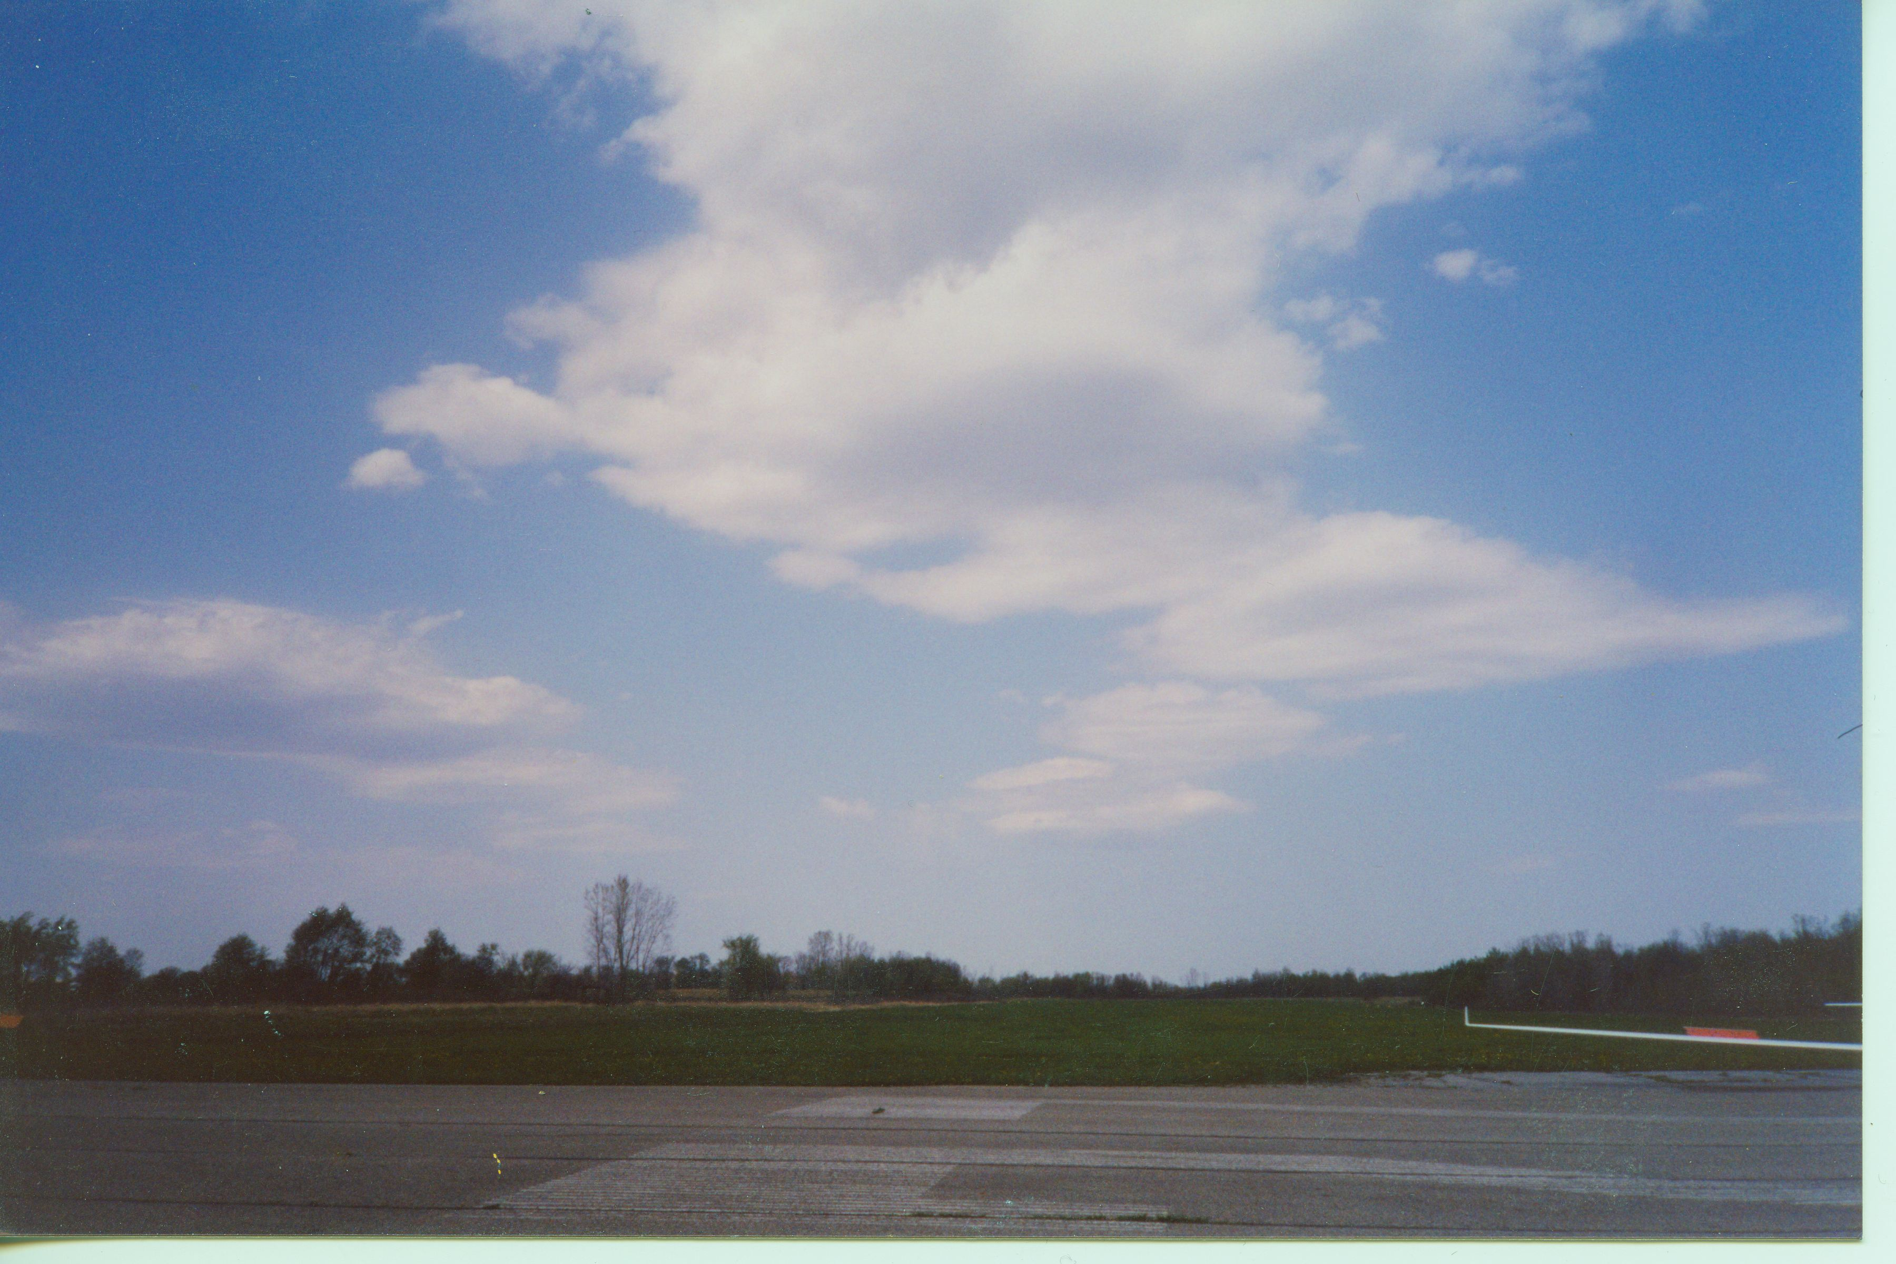
April 24, 1998: Jack Steen/Rich Mozer, Dave Nelson, Michigan

Slide 61
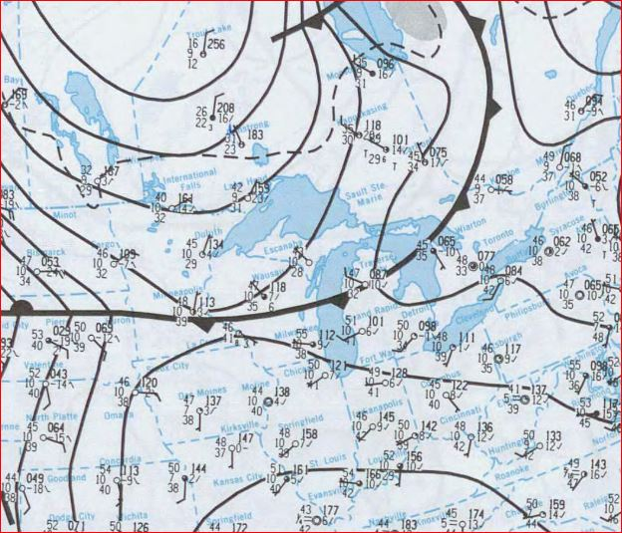
April 24, 1998 weather map Note nearby front...

Slide 62
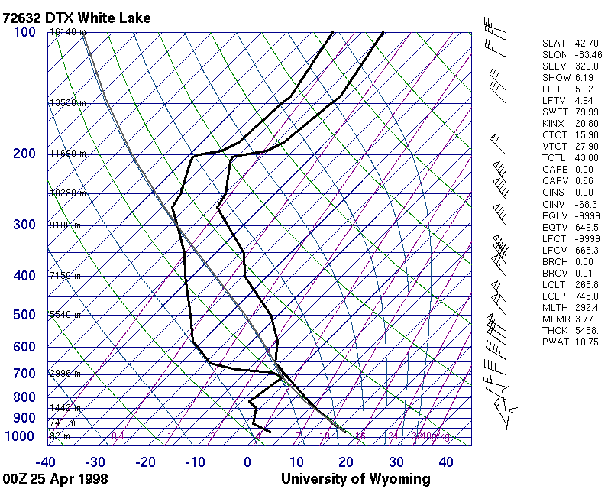
April 24, 1998 sounding 8 pm, DTX (500mg ~ 18k ft – 700 mb ~10k ft – 850 mb ~5k ft)

Slide 63
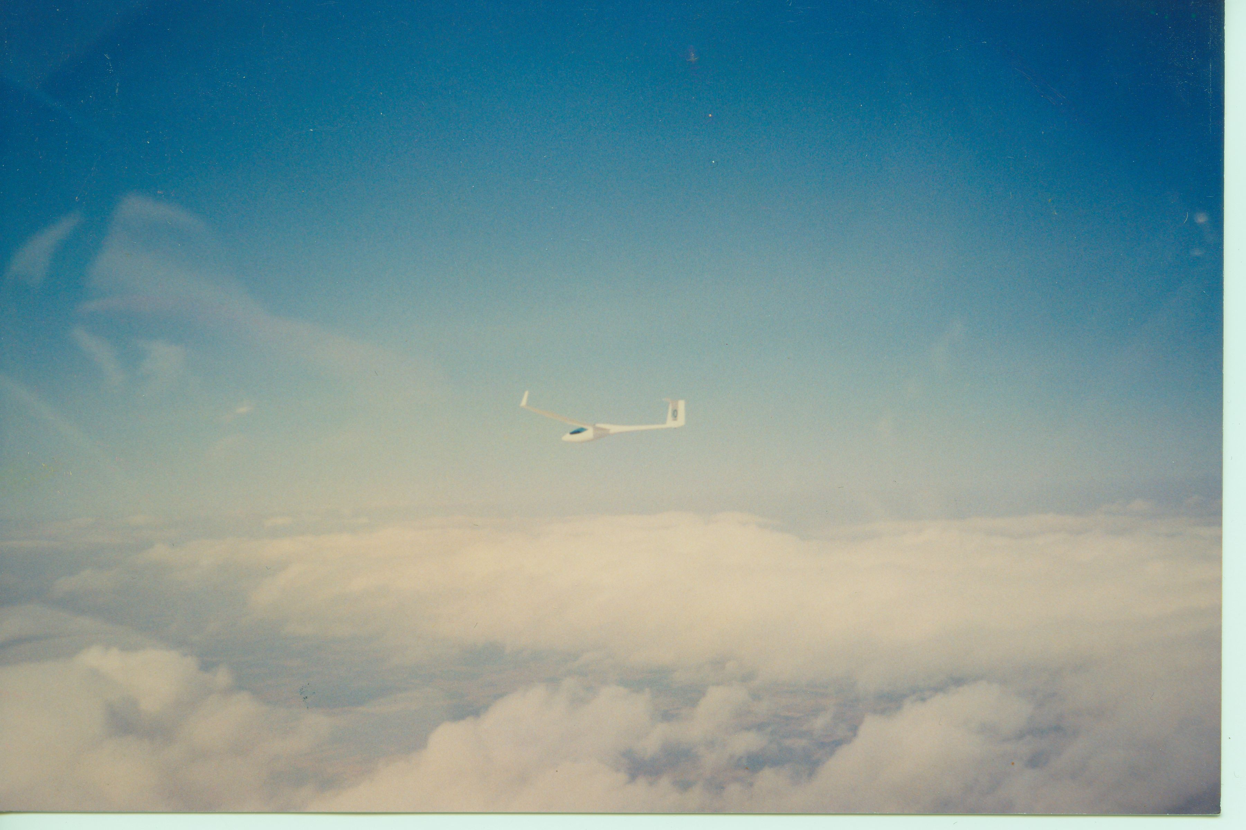
Jack Steen near FL 140 in the Ionia Wave

Slide 64
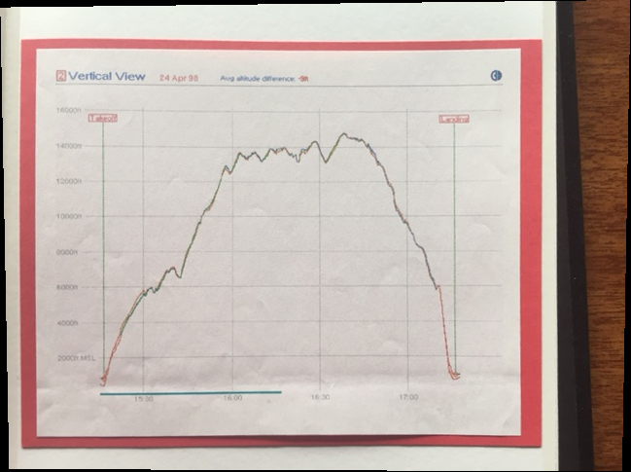
Vertical trace

Slide 65
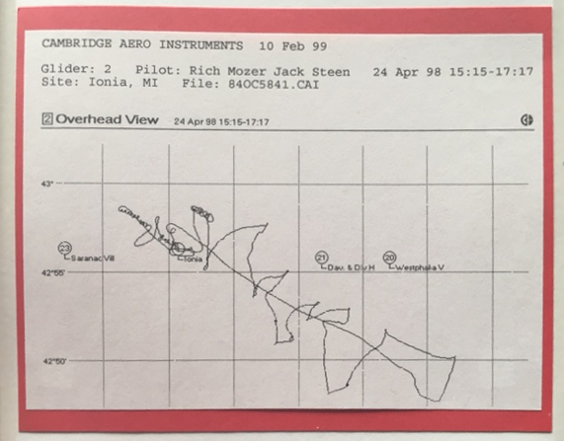
Horizontal trace

Slide 66
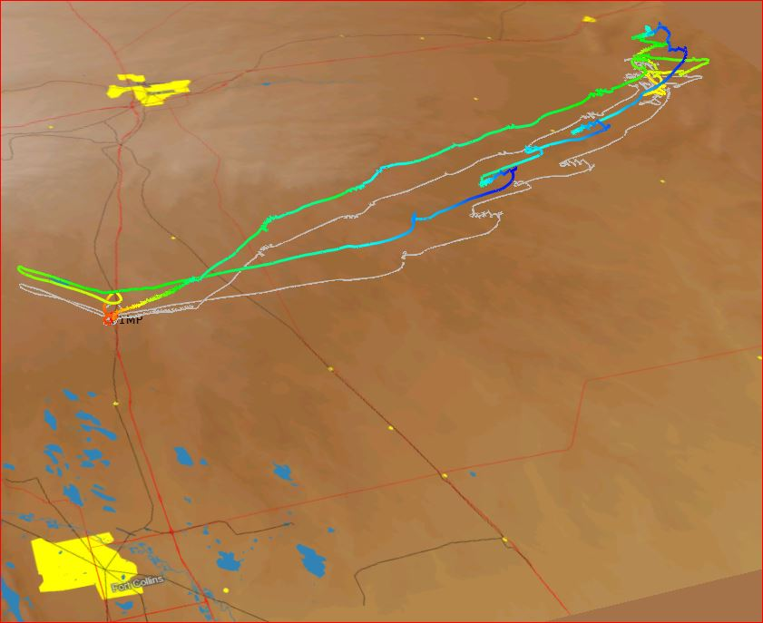
Bob Faris, Sept 12, 2003 – Nebraska (Fort Collins foreground, Cheyenne background)

Slide 67
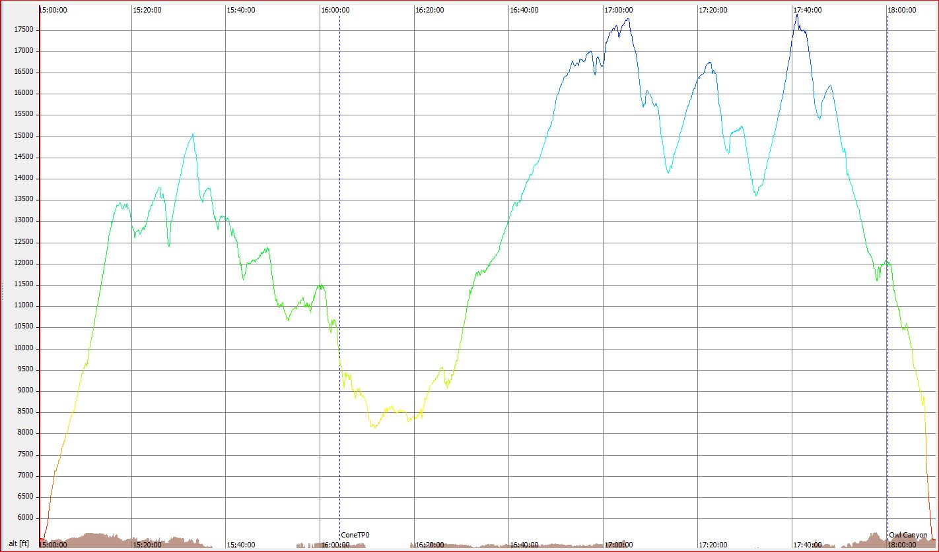
Vertical trace

Slide 68
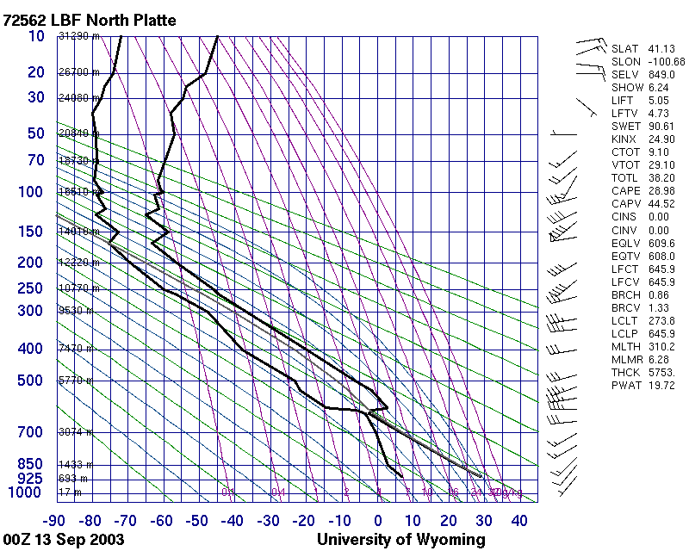
Sounding North Platte (500mg ~ 18k ft – 700 mb ~10k ft – 850 mb ~5k ft)

Slide 69
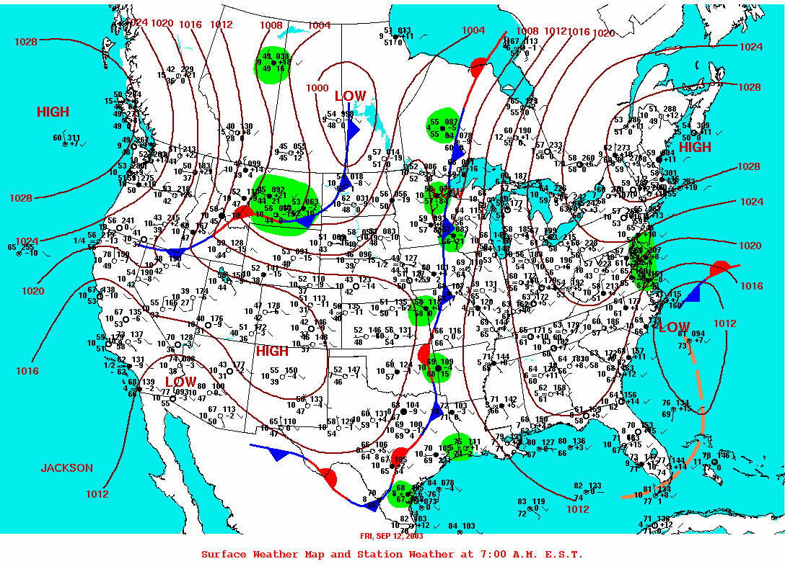
Weather map

Slide 70
Bob Faris
9/12/2003 Nebraska altitude record
...this flight was made in a thermal wave system. I got off of tow fairly low in strong thermal conditions from Owl Canyon with a declared start point in Nebraska with the intention of setting several state records. The flight out to Nebraska was made mostly in pure thermal lift. The cloud bands were moving to the east with a N/S alignment. The initial wave propagation was probably from the continental divide to the west. After getting to the start point, I was able to climb in a mix of thermals and wave to reach the record altitude. I thought that returning to Owl Canyon against the strong west wind was going to be difficult, but I was able to climb enough in each wave to make the jump across to the next wave above the cloud lines. It was an interesting day and I haven't seen the same conditions since. I think the most unique part was that the entire wave system moved to the east, rather than staying fixed over the ground as it normally does in this area.

Slide 71
Bob Faris, Sept 12, 2003 - Nebraska

Slide 72
Don Gurnett, May 3, 2014, Iowa (SW of Muscatine)

Slide 73
Don Gurnett:
Departed Muscatine (MUT) on a very windy day, about 20 knots from northwest, numerous cu with cloud base about 7,500 ft agl.
After exiting a climb upwind near cloudbase I encountered wave lift and climbed well above the clouds in what appeared to be a well developed cloud street and climbed to around 3750 meters,
then penetrated upwind to above and ahead of the next cloud in the street where I again started climbed in wave to over 4000 meters.
As it was freezing cold and since I did not have oxygen I started a descent and landed at Muscatine.
Wind in the wave was about 50 knots at about 300 degrees.
Near cloud base wind was from the same direction at 38 knots,
and about 16 to 20 knots near the ground when I landed.

Slide 79
(700 mb ~10k ft – 850 mb ~5k ft) (Davenport sounding not available)

Slide 80
Ted Clausing, Sept 14, 2014, Wisconsin

Slide 83
(700 mb ~10k ft – 850 mb ~5k ft)

Slide 84
1615z = 1115 CDT

Slide 85
1715z = 1215 CDT (takeoff)

Slide 86
1815z = 1315 CDT

Slide 87
1915z = 1415 CDT (end of flight)

Slide 88
2015z = 1515 CDT

Slide 89
2115z = 1615 CDT

Slide 90
2215z = 1715 CDT (suppertime)

Slide 91
Finding Convective Wave
Shear in velocity or direction is important
Consider “shear” of density d/t humidity difference...
Shear and velocity and instability tend to come together ahead of and behind cold fronts
Think about taking a high tow under a post-coldfront overcast
Especially near the western edge of the “disc” of clouds (developing and enlarging breaks between lines)
Do avoid the “downwind” side of “streets”...

Slide 92
FINI !!
I hope that you have questions,
But I have few answers.
(I'm not an expert; I'm an explorer of knowledge)
I live at the margin of a vast universe of ignorance...
dleroyj@gmail.com = soaring stuff
johnson.danl@mayo.edu = work email
At the convention: text 715-556-2319

